Slide 1

CAVA – Log in

Slide 2
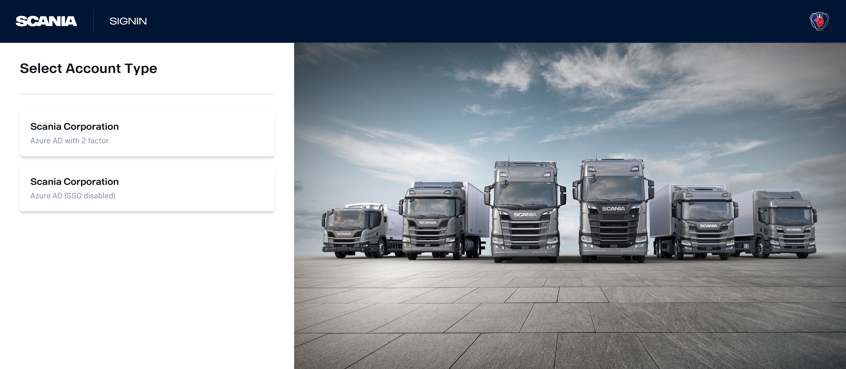
Log into CAVA BACK OFFICE
Enter: https://cbo.scania.com
If you need to add a new user, contact:
ssdg@scania.com
Information needed:
Subject: Access for CAVA Bodybuilder
XDS user name
ETEL Back Office Market ID
Please ask your SCANIA presales contact in your market.
Notes:
First you need to go to the internet browser and search for cbo.scania.com
Then you have two possibilities to select.
2 factor authentication here you need to fill in your Username and Password and select the method you are preferring SecureID/Token or SMS to your mobile phone. When you got the one time password you need to enter it and Log In.
The ordinary Scania XDS account

Slide 3

CAVA – Your specifications

Slide 4
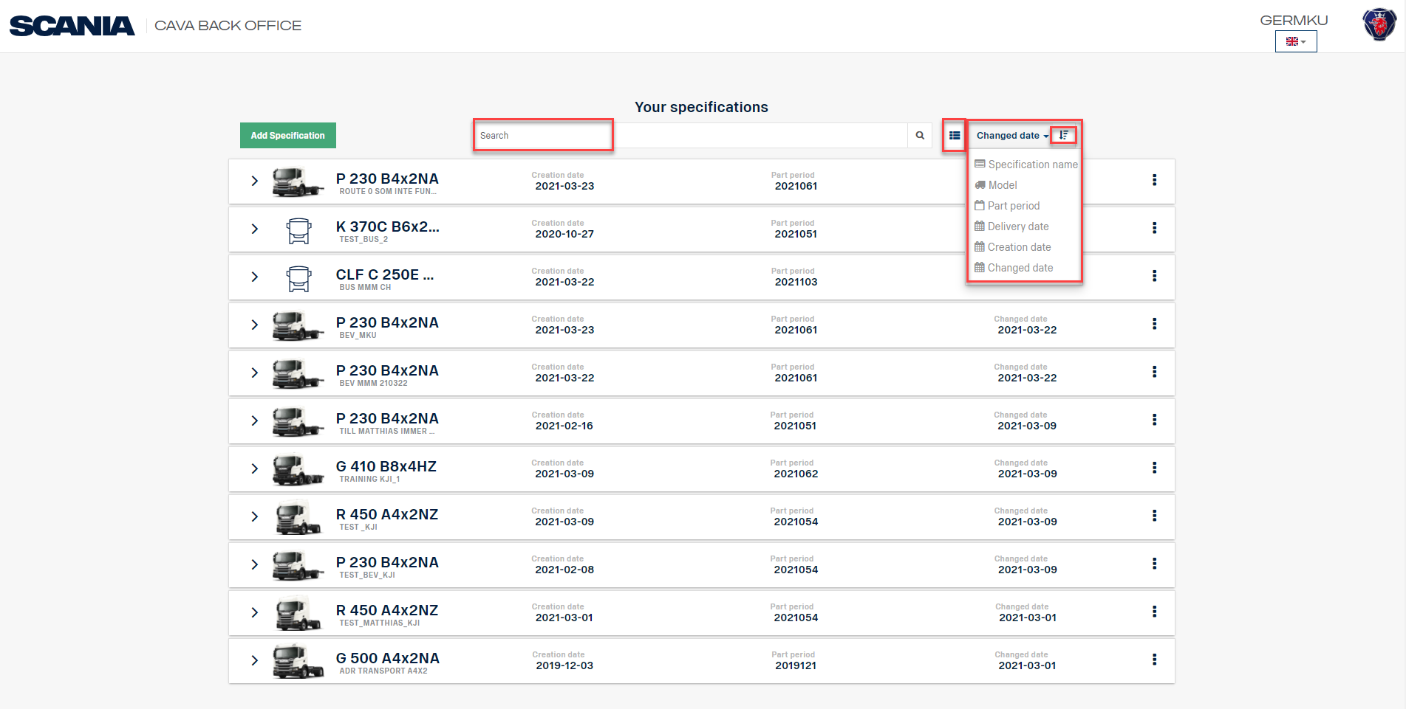
Filter, View and Sort
Freetext Search
View
Ascending descending
Filter
Notes:
There are a few options to search and filter on your specifications. Searching with free text for example. Two views are available first the list view and second the picture view. In this views there are different filter functions integrated. Eighter ascending or descending or by Creation date or Change date as well as Part period and so on.

Slide 5
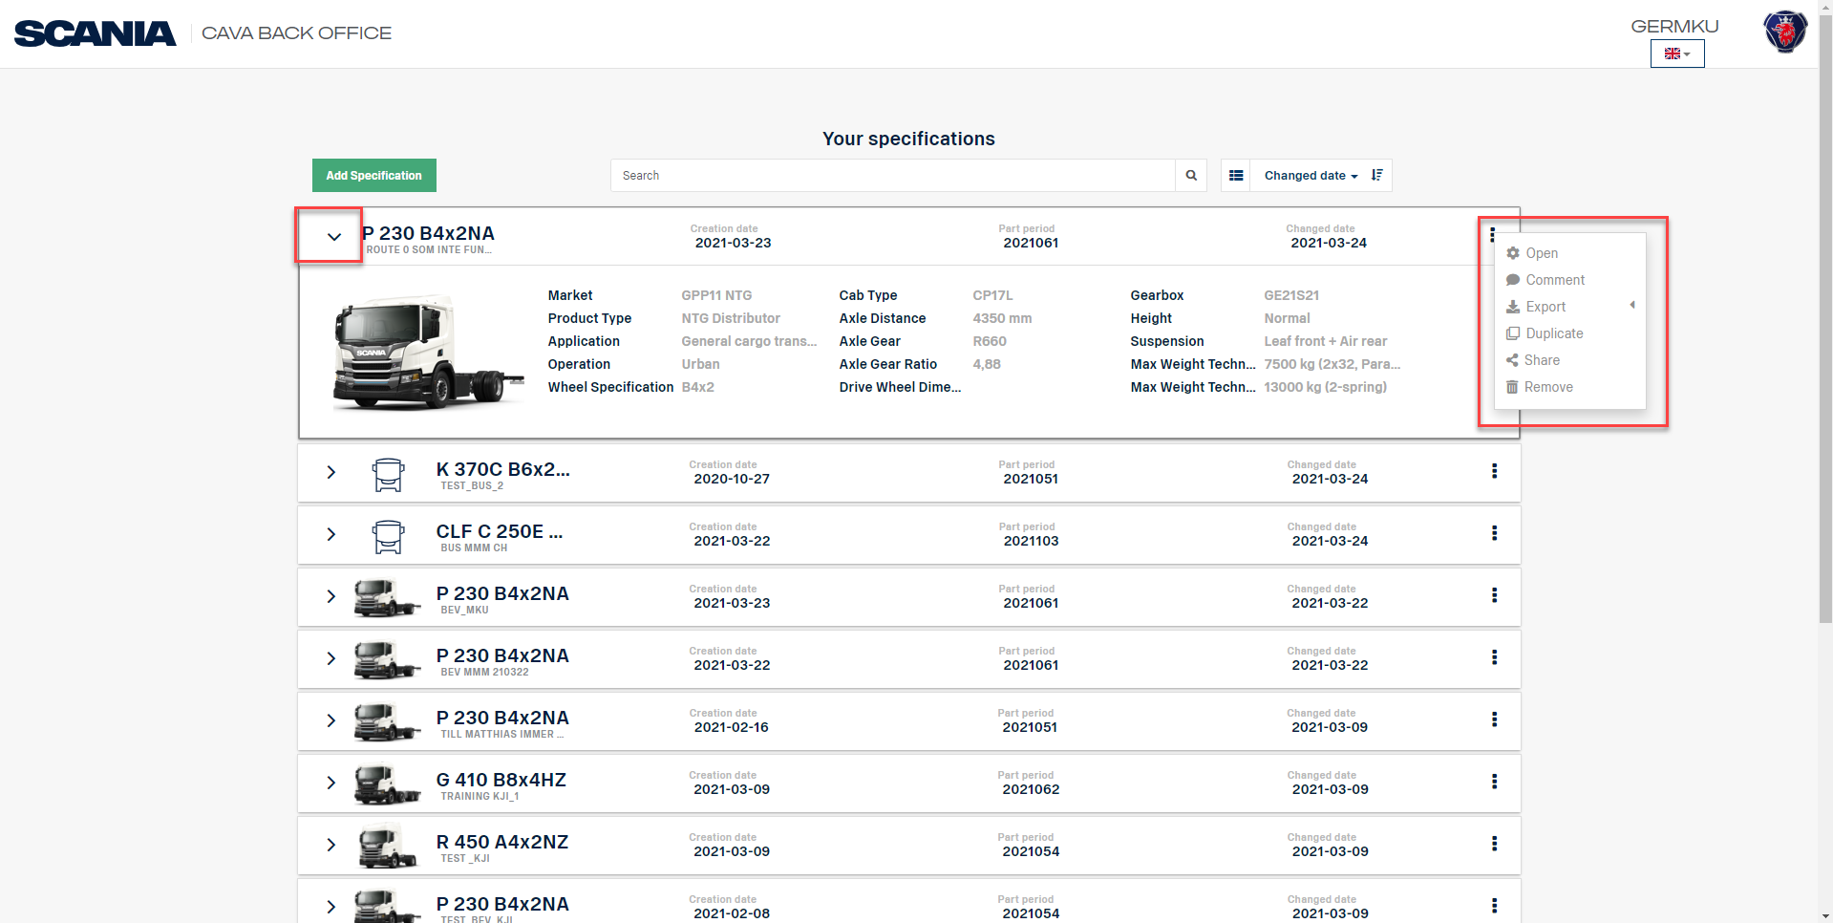
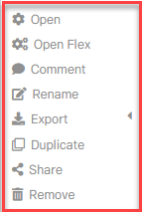
Specification Options
Klick on the three dots
Expand to see more information
Available Specification Options
Notes:
If you are expanding the specification, you have created it is possible to see more information like cab type, gearbox, axle distance and so on. When clicking on the tree dots you have different options to choose like open the spec. add a comment, export function, Duplicate the spec. share the specification which is a great function without using e-mail and last to remove the spec.

Slide 6
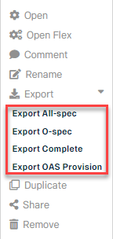
What method for EXPORT?
From
Use
To
CBO
All-spec
CBO
CBO
Complete
Sales Portal
Notes:
To explain what method to choose when. From CAVA Back Office to Sales Portal please select O-spec. From CAVA Back Office to CAVA Back Office please select Complete. All-spec export is mainly used at R&D.

Slide 7
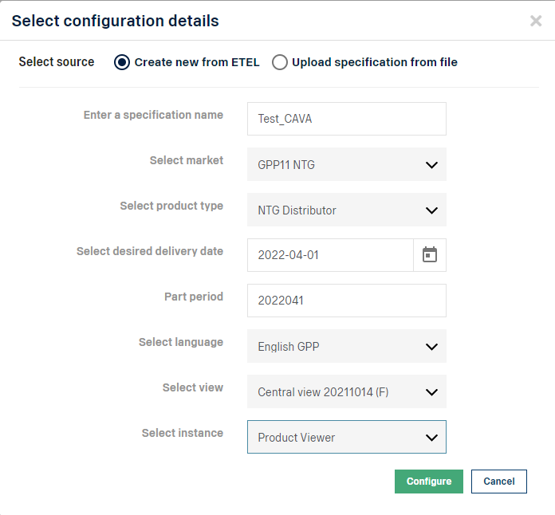
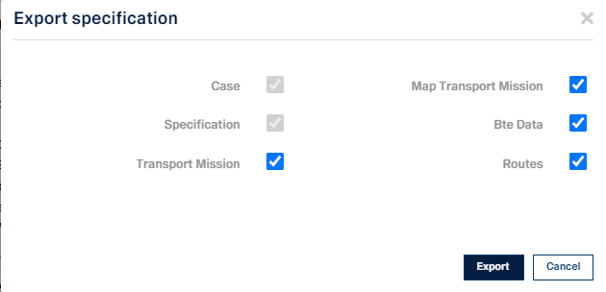
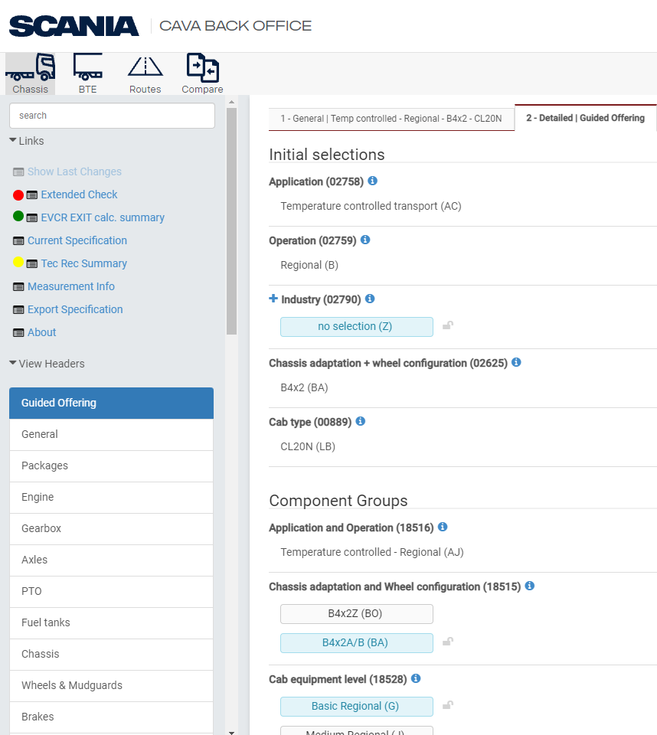
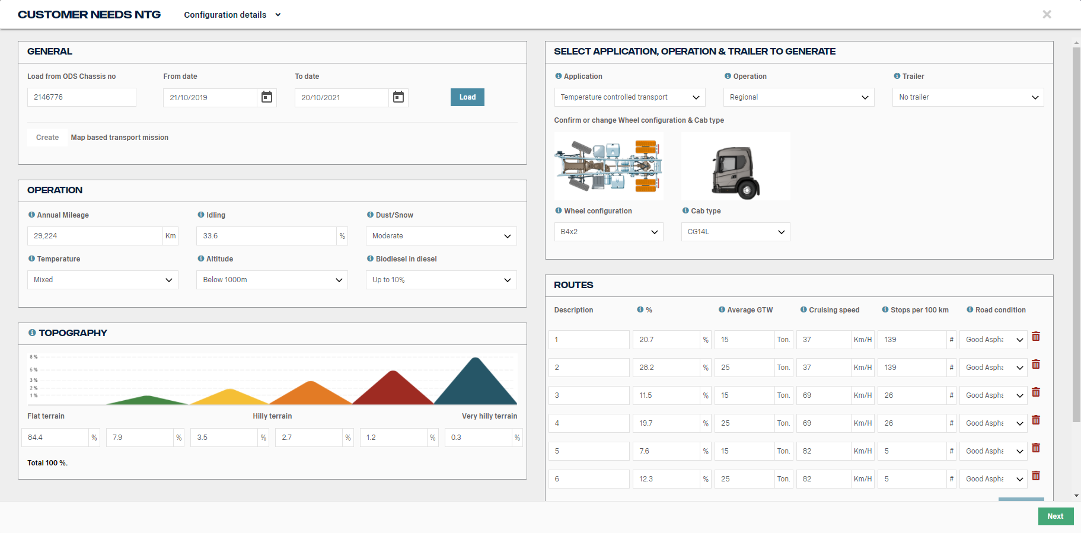
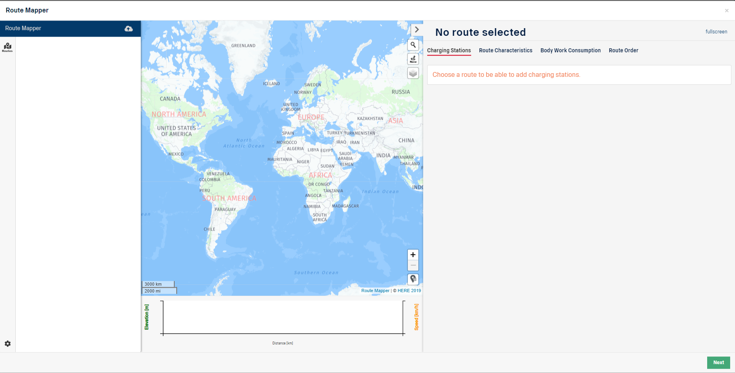
What Export Option Complete Means?
Case
Configuration details
Specification
Complete SECM specification
Transport mission
Customer needs
Map Transport mission
Rout mapper
Notes:
I would like to explain what the different options by exporting complete specification means.
Case: Configuration details
Specification: Complete specification based on the scania configuration module (SECM)
Transport Mission: Customer needs information
Map Transport Mission: Rout mapper information

Slide 8

CAVA – create New specification
Notes:
In this chapter I will show you the different methods how to create a new specification in CAVA Back Office

Slide 9
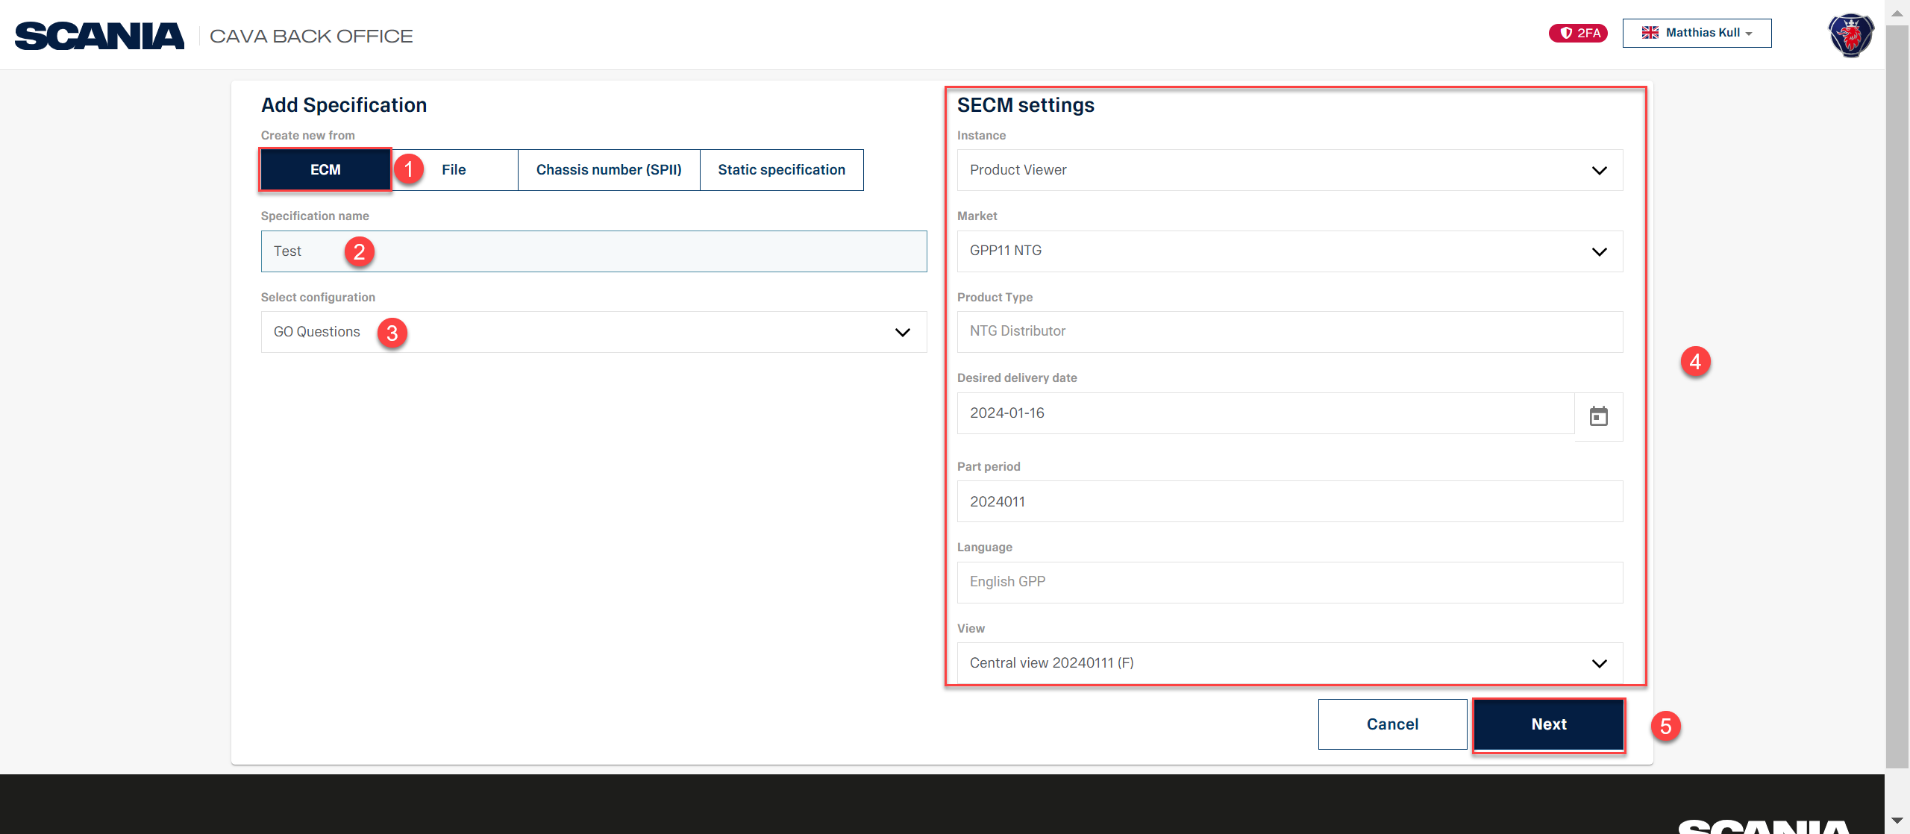
Create new specification from ECM
Notes:
Create a new specification from ECM (ETEL Configuration Module) please follow the steps highlighted in red.
This means you will create a new specification from scratch according to the ETEL Product structure you have selected for your Market.

Slide 10
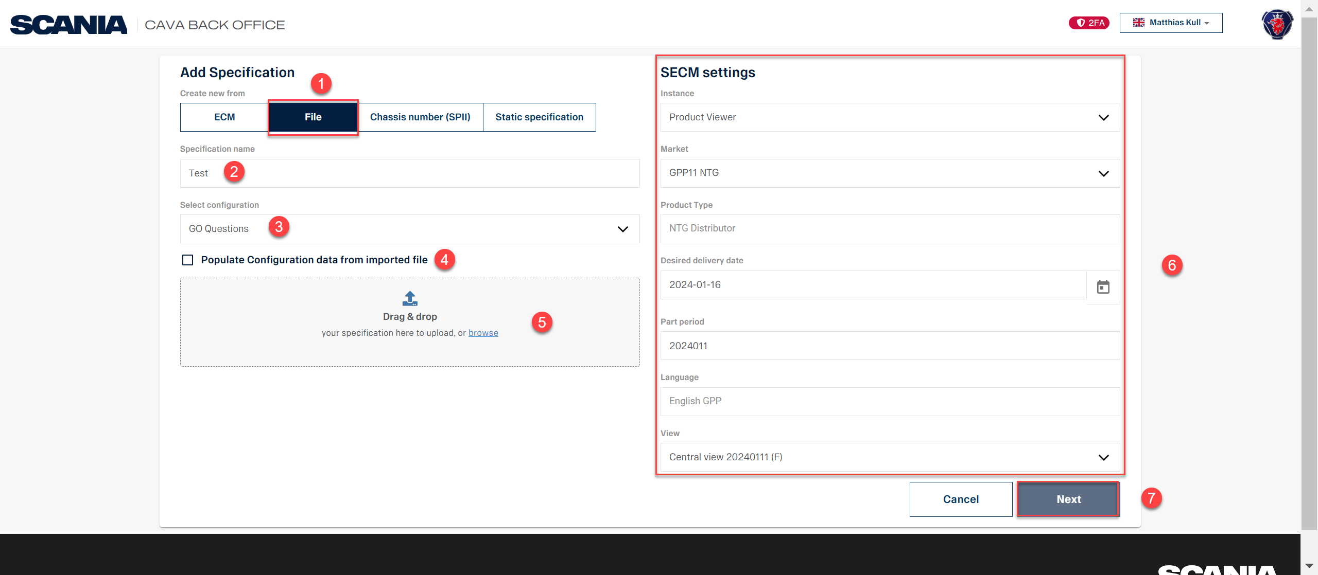
Create new specification from File
Notes:
Create a new specification from File follow the steps highlighted in red.
This means you will create a new specification using a stored xml file on your computer.

Slide 11
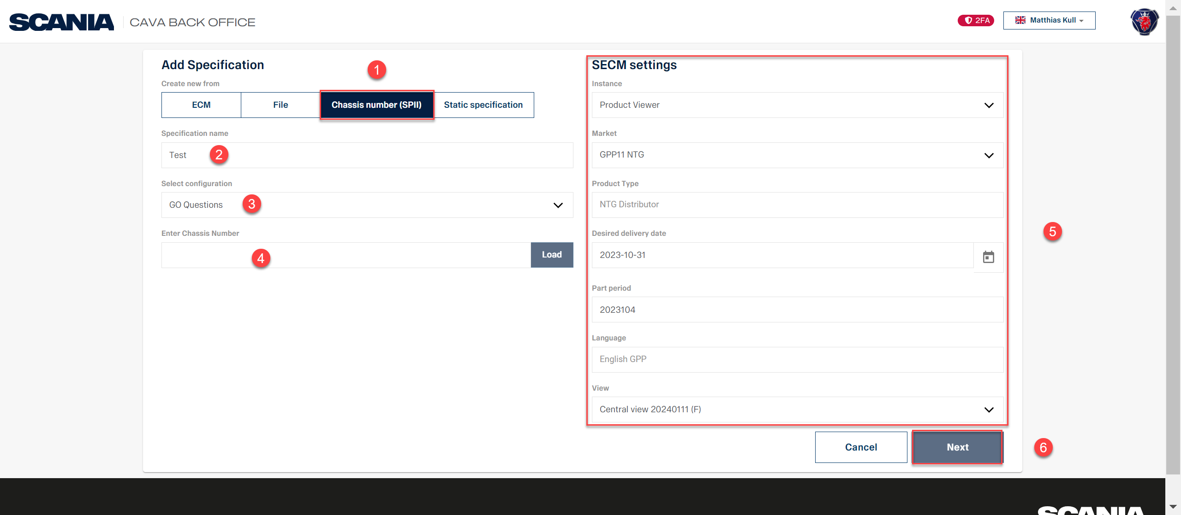
Create new specification from chassis number (SPII) select configuration GO Questions
Notes:
Create new specification from chassis number (SPII) and selecting configuration GO Questions follow the steps highlighted in red.

Slide 12
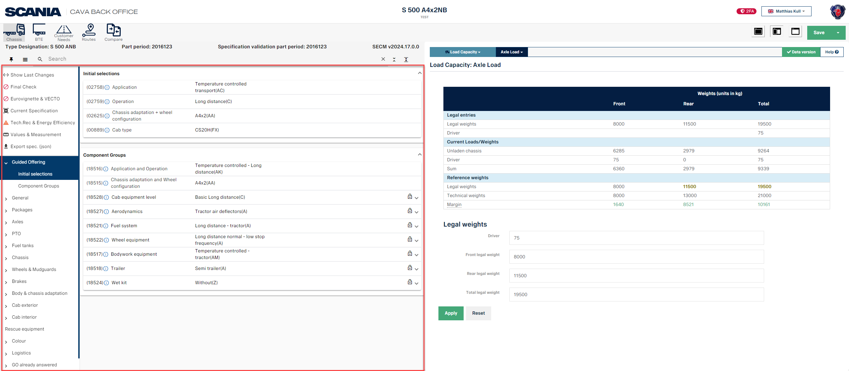
Create new specification from chassis number (SPII) select configuration GO Questions
Notes:
When using the method GO-Questions you are able to change the specification with the Scania ETEL Configuration Module (SECM).

Slide 13
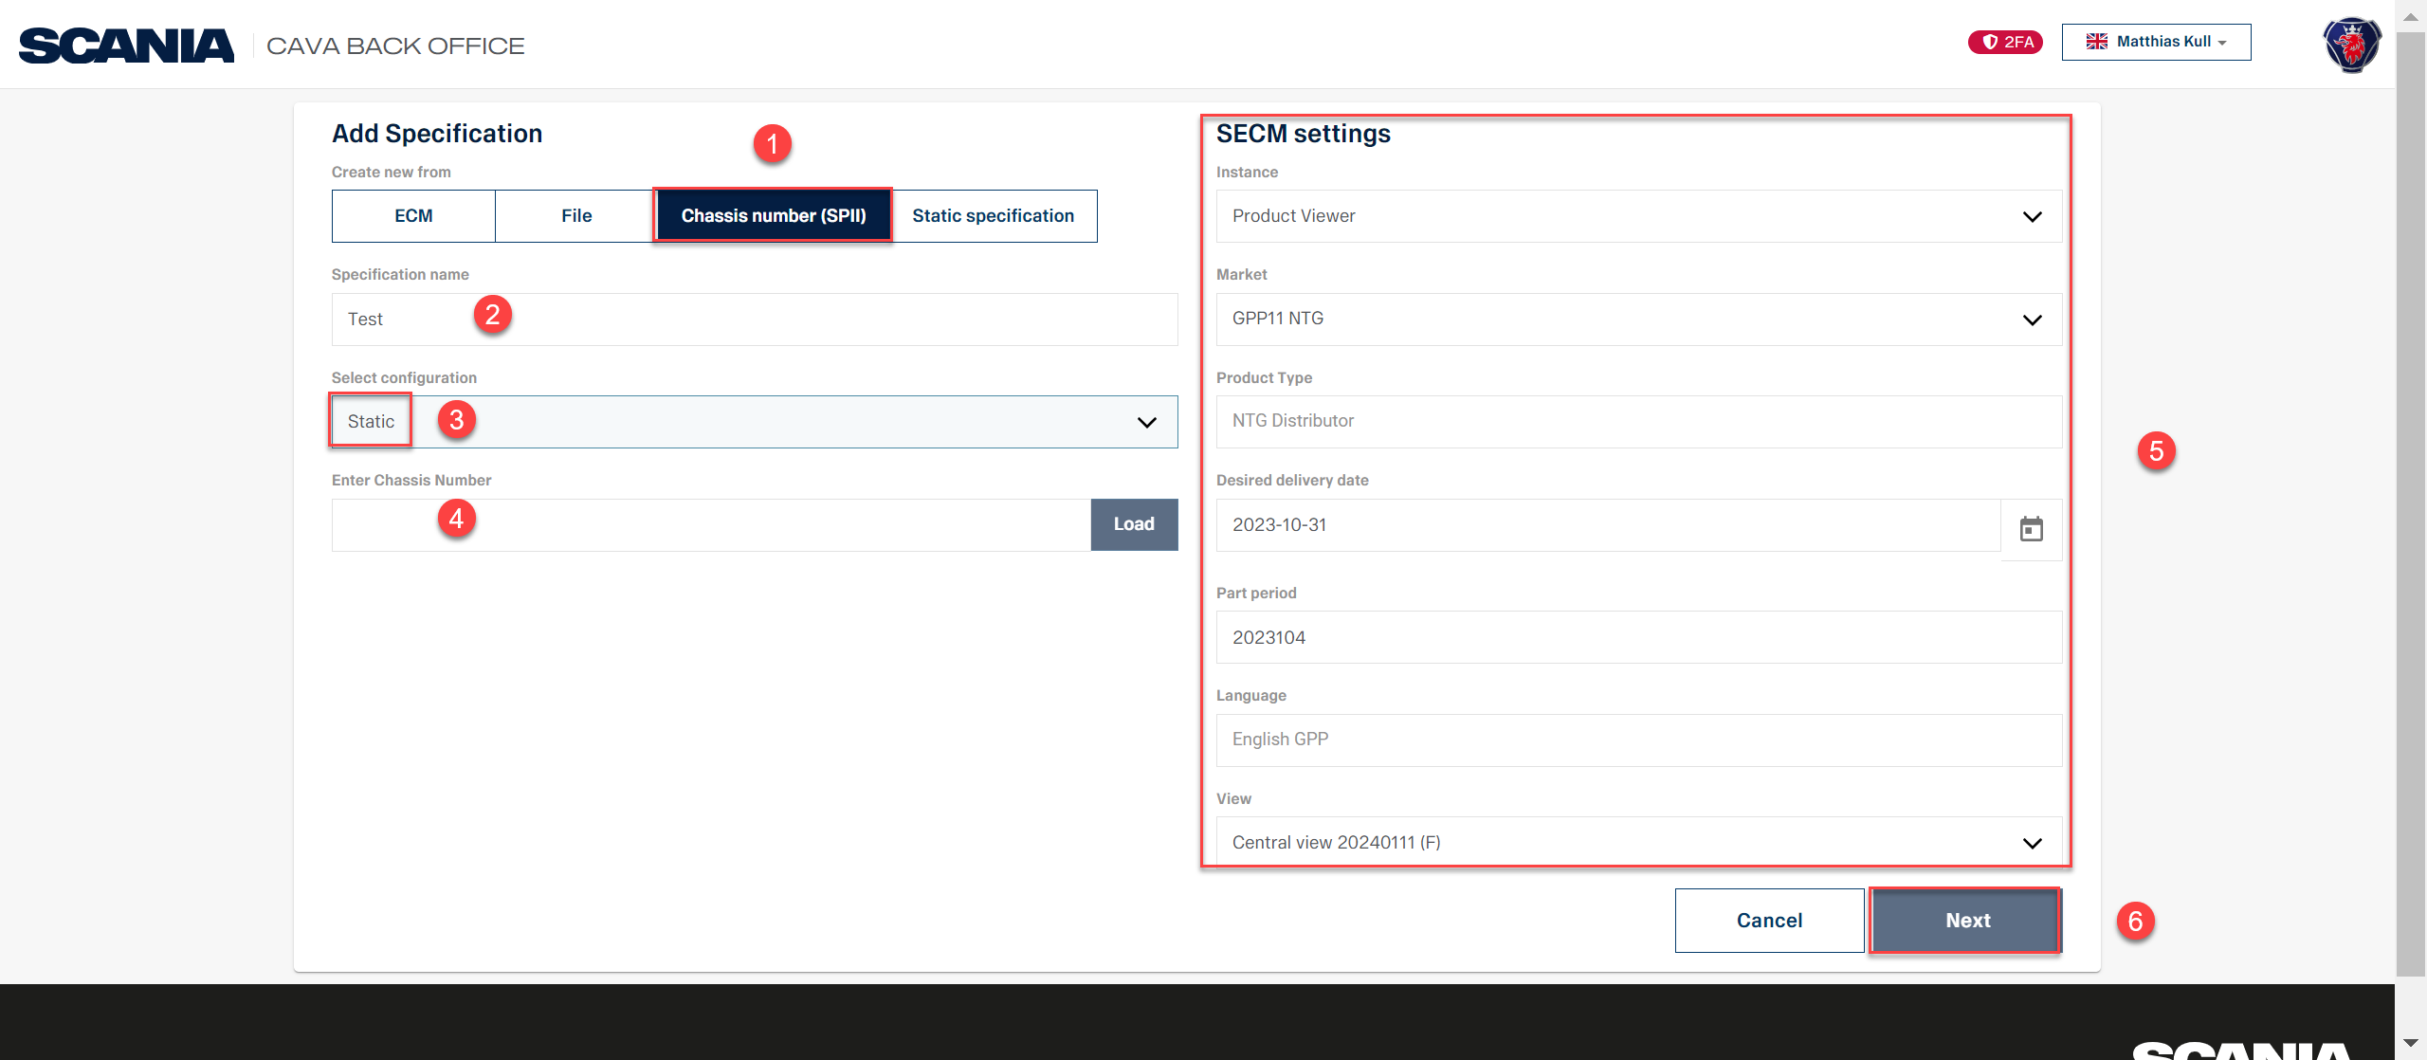
Create new specification from chassis number (SPII) select configuration Static
Notes:
Create new specification from chassis number (SPII) and selecting configuration Static follow the steps highlighted in red.

Slide 14
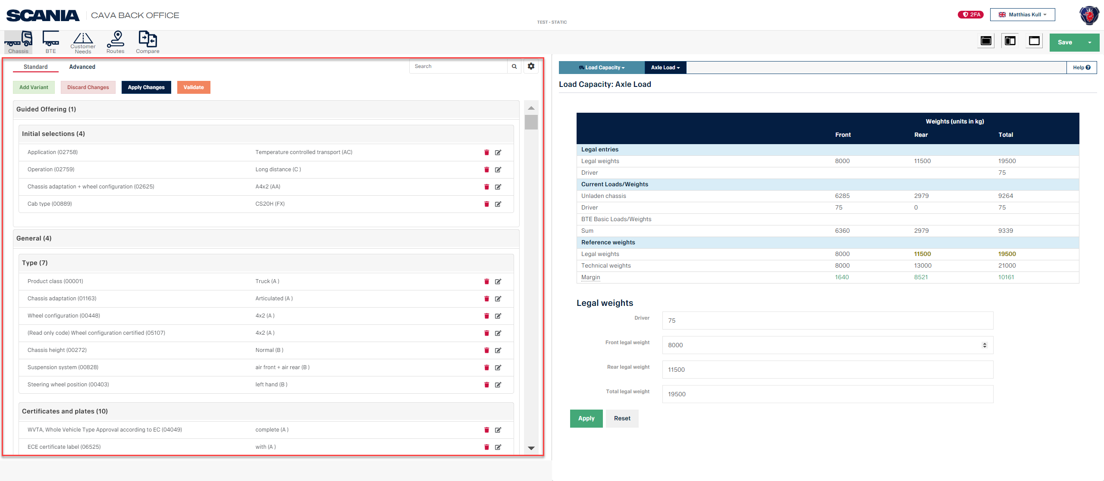
Create new specification from chassis number (SPII) select configuration Static
Notes:
When using the method “Static” the Scania ETEL Configuration Module (SECM) is not available highlighted in red.

Slide 15

Cava – CUSTOMER NEEDS

Slide 16
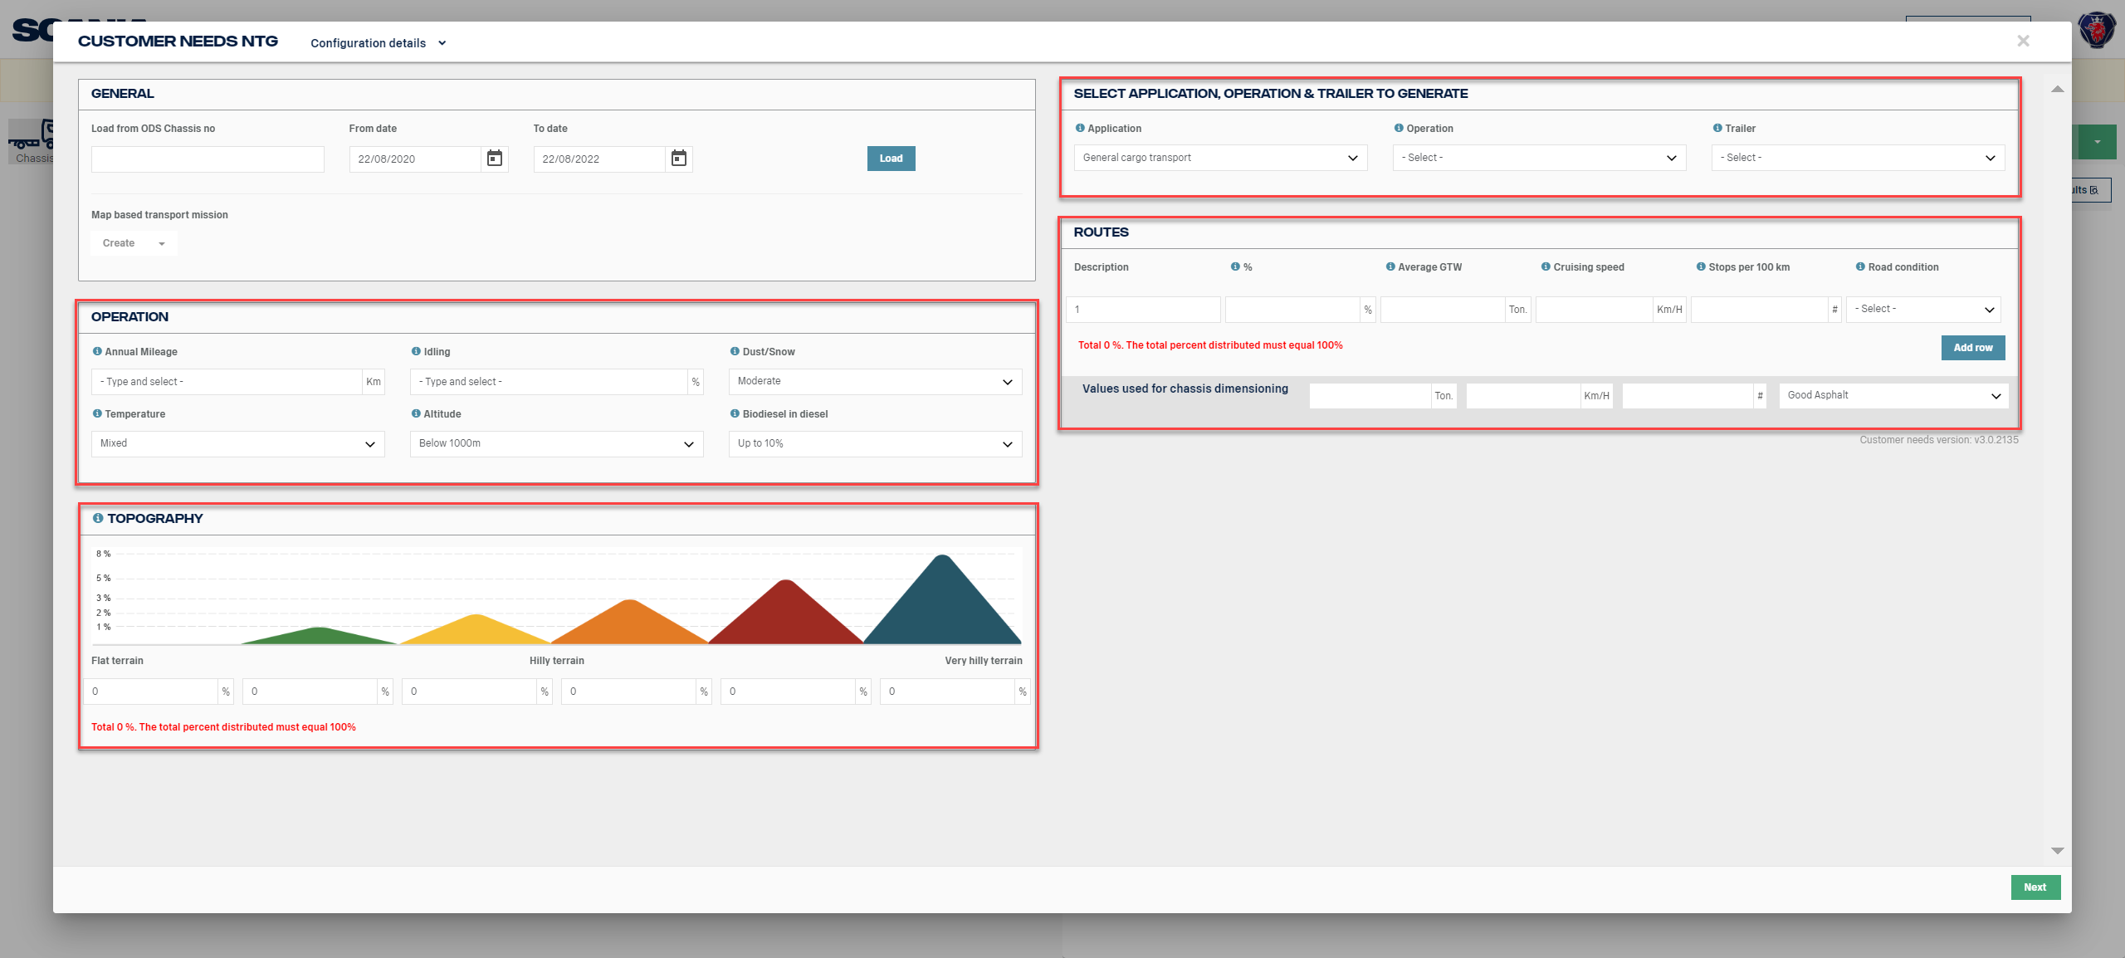
Customer Needs (manually filled)
Fields that are not filled in automaticly in customer needs to be filled in manually
Notes:
You can fill in the red highlighted fields manually in Customer Needs, which we do not recommend.

Slide 17
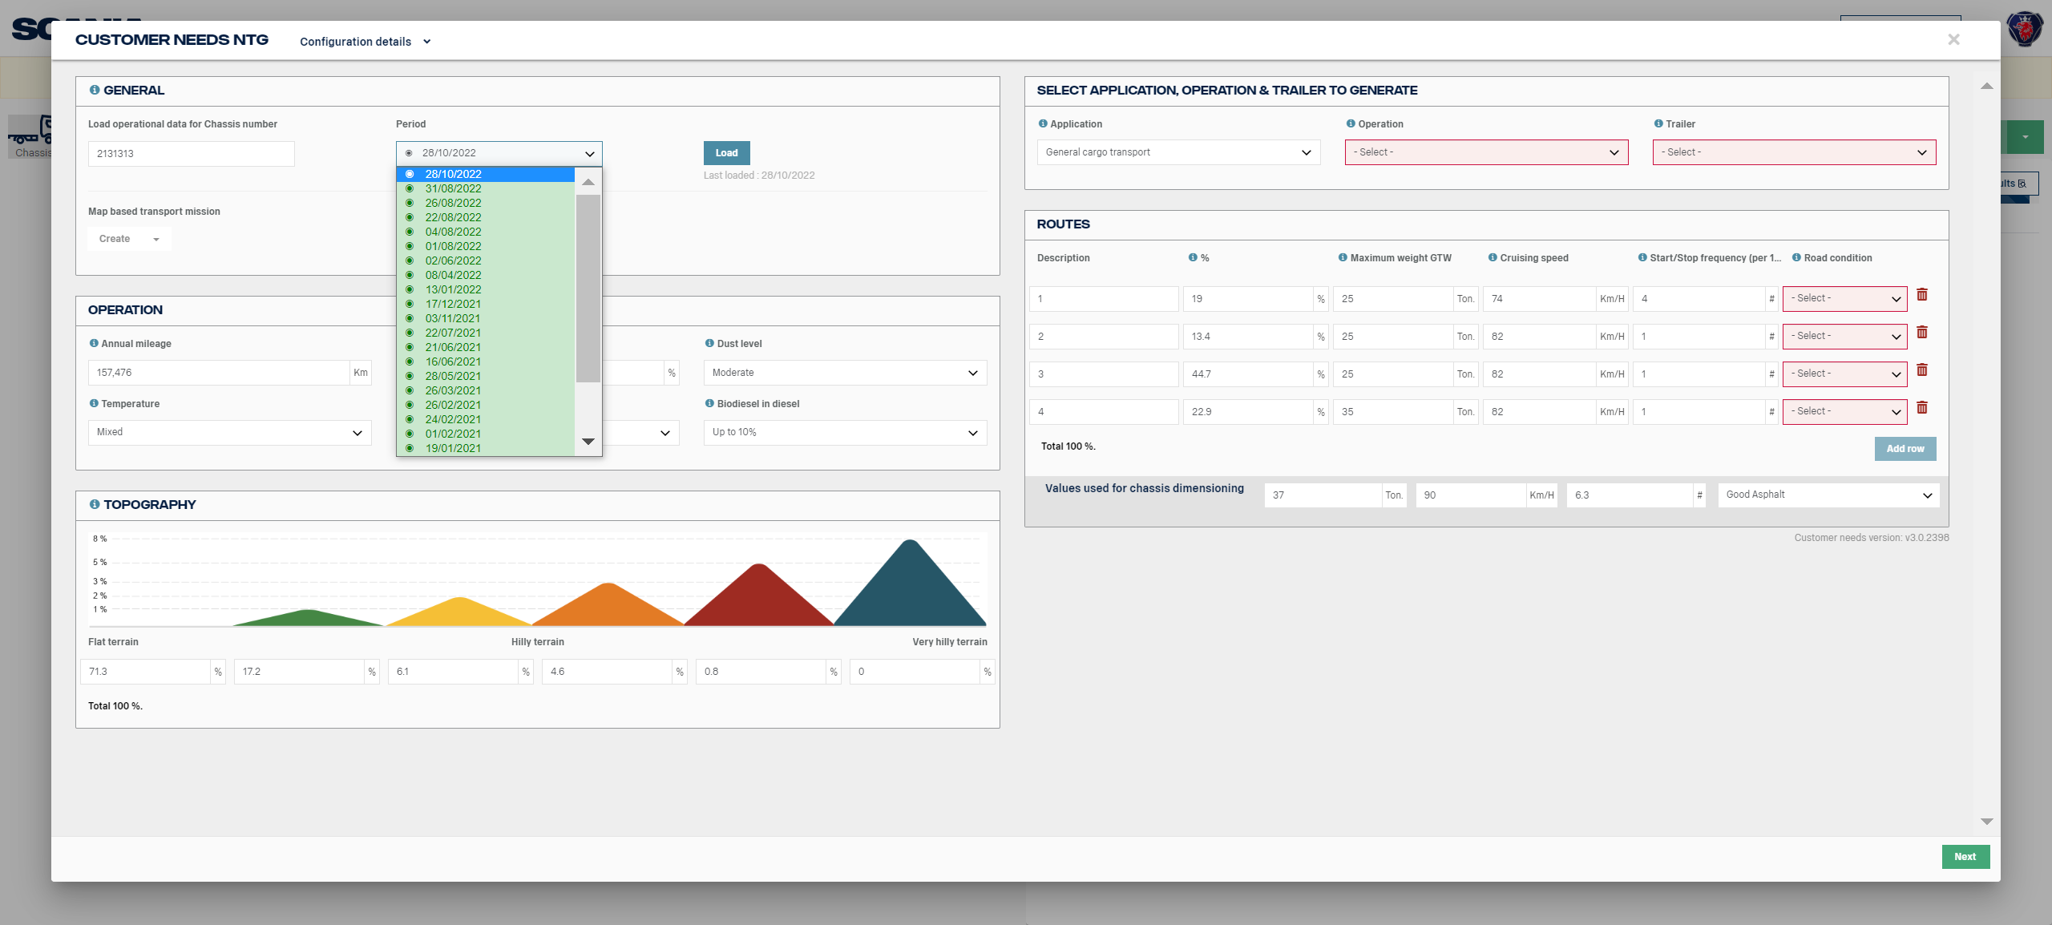
Customer Needs (Load Chassis Number)
Click Load to fetch the operational chassis data
Enter Chassis number
Notes:
When you enter a chassis number you get the latest full data set and a list of which other data sets that are available select one and click on Load. To get more detailed information please click on the blue information “i” in the “General” section. The operational data from ODS (Operational Data System) will be fetched and automatically filled in Customer Needs which we strongly recommend. You need to fill in Application, Operation & Trailer as well as Wheel configuration, Cab and Road condition.

Slide 18

Cava – Modules

Slide 19
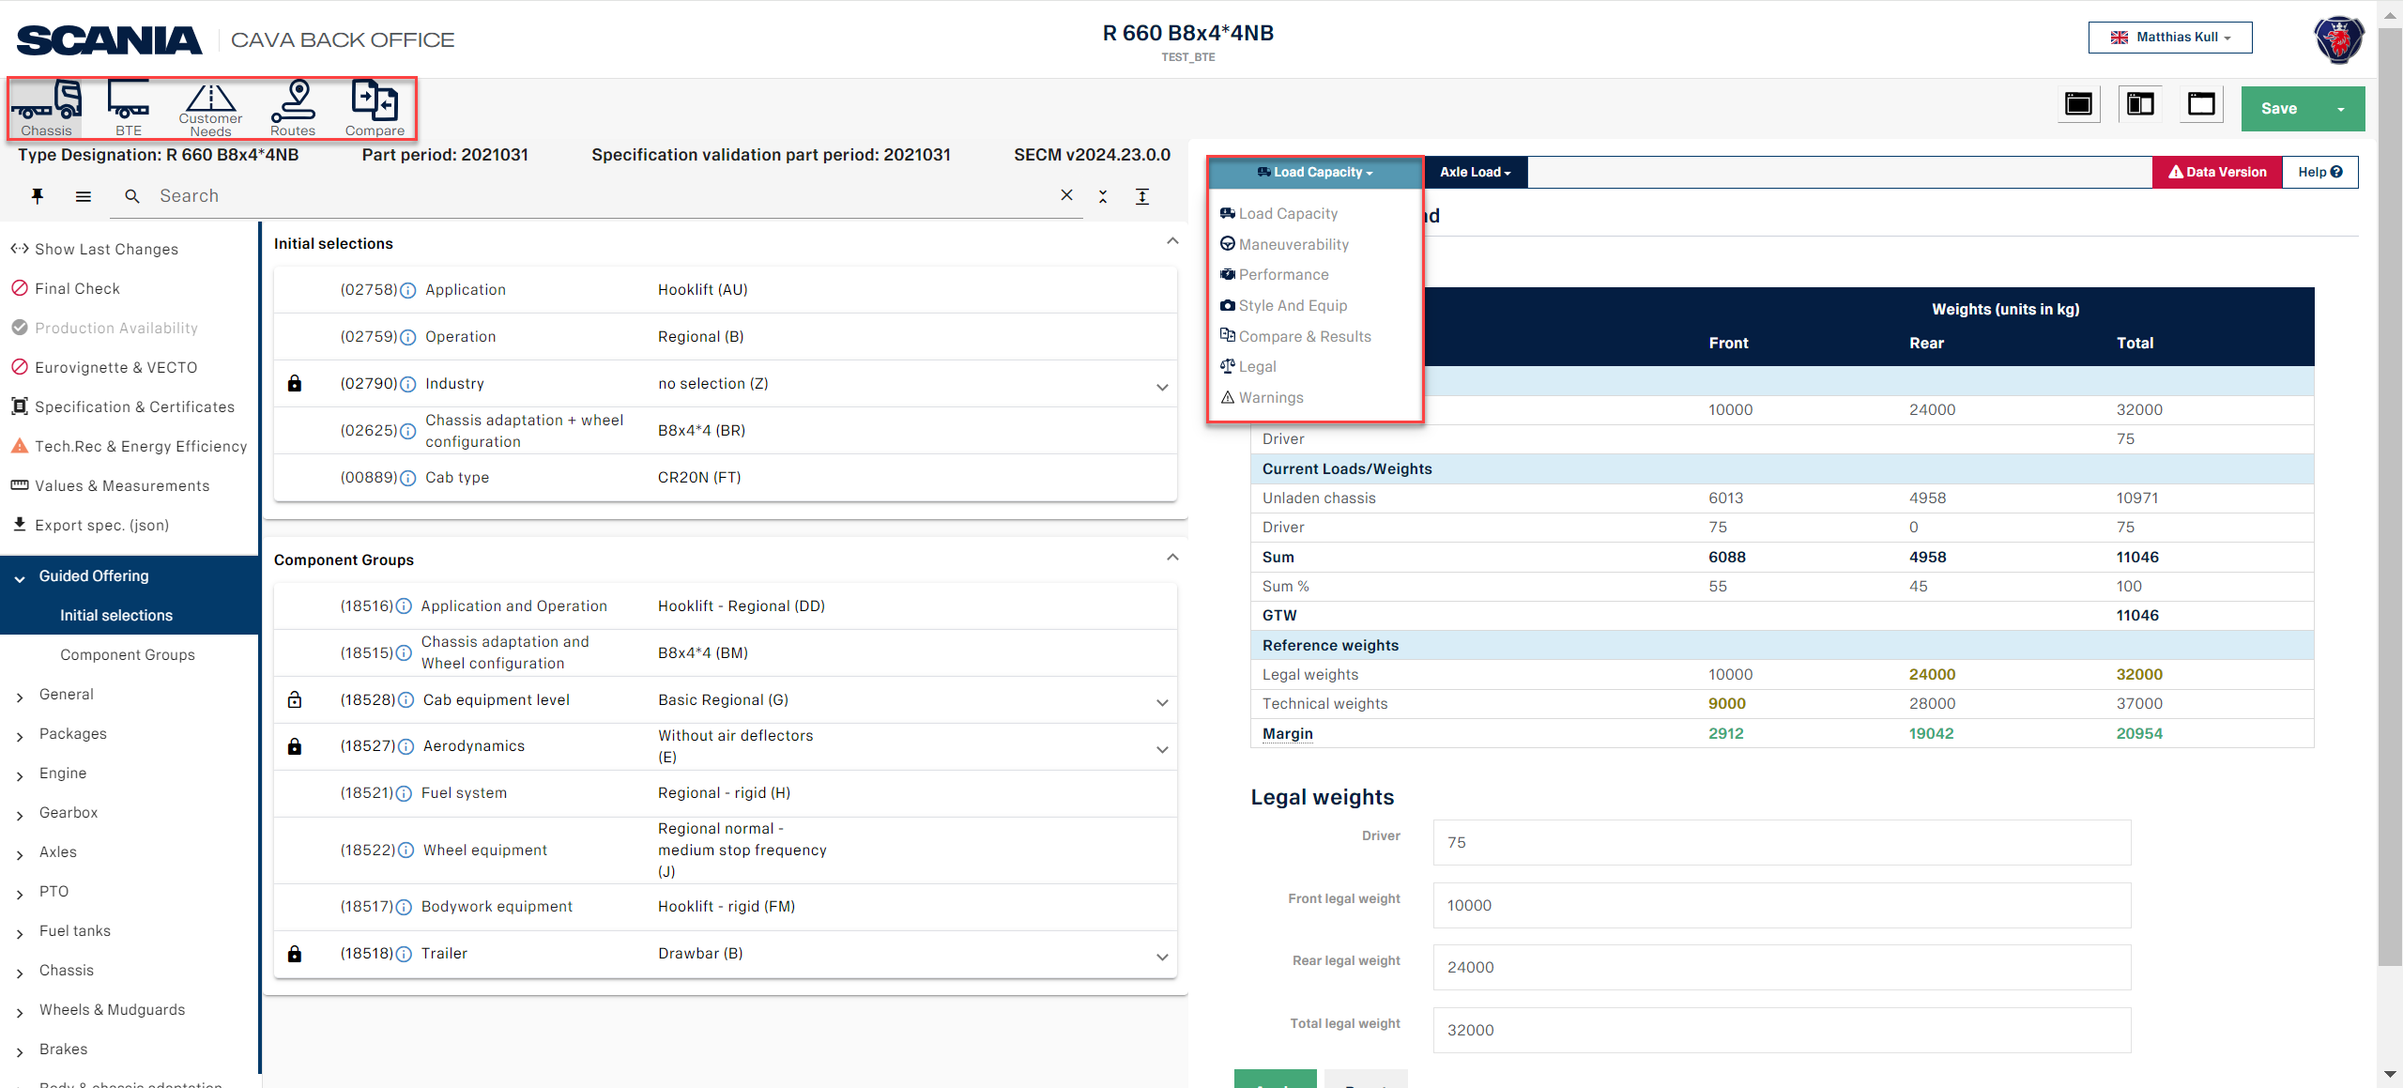
CAVA Back Office Modules
Open the dropdown to enter the CAVA Modules
Notes:
When you have entered the start page of CAVA Back Office you will find on the left-hand side highlighted in red different Options to select Chassis, BTE (Body Trailer Equipment), Customer Needs, Routes and Compare.
On the right-hand side highlighted in red click the drop down to open the Modules, Load Capacity, Manoeuvrability, Performance, Style and Equip, Compare & Result and Legal.

Slide 20

Cava – Load module

Slide 21
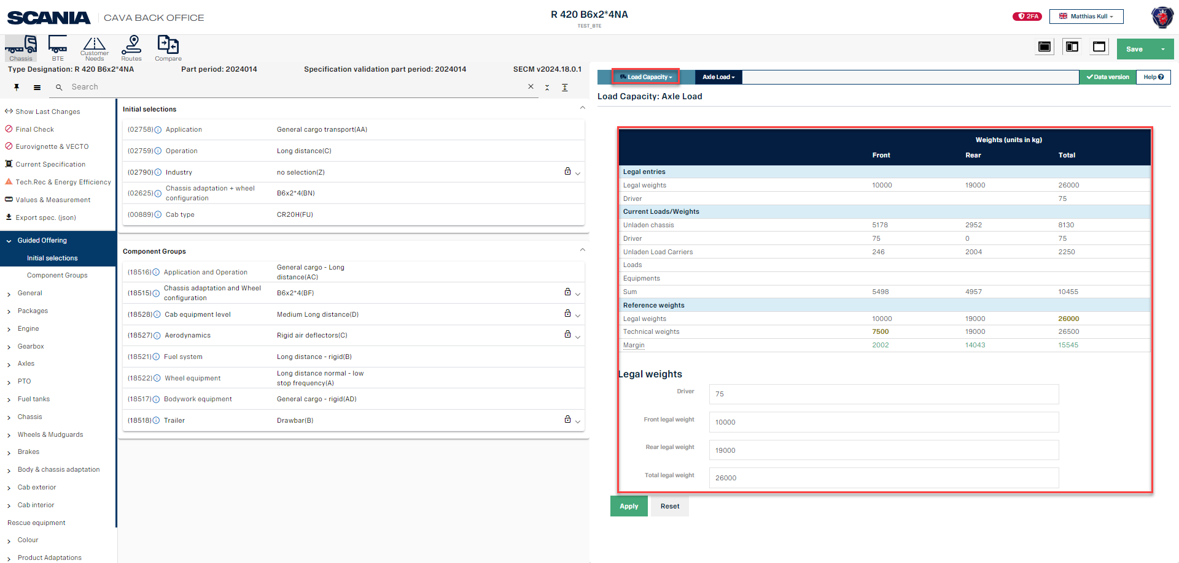
Load Capacity
Notes:
Load Capacity module, where the legal weights (front, rear and total) as well as driver weight are filled in automatically according to the EU legislation. If you have other legislations, you can adjust the legal weights manually.
In the lower table, the unladen chassis weights from the Weight Calculation Program are shown (Front, Rear and Total), along with the Driver weight, the Sum of these weights.
If you have selected an trailer the load capacity of the trailer will be shown in a own tab.
Under Reference weights, Legal weights are shown, along with the Technical weights.
Finally, the Margin, based on the lowest reference of legal and technical weights, is shown in green.
Note that the unladen chassis weights and the margin will also be shown in Basic Drawing, as mentioned earlier.

Slide 22
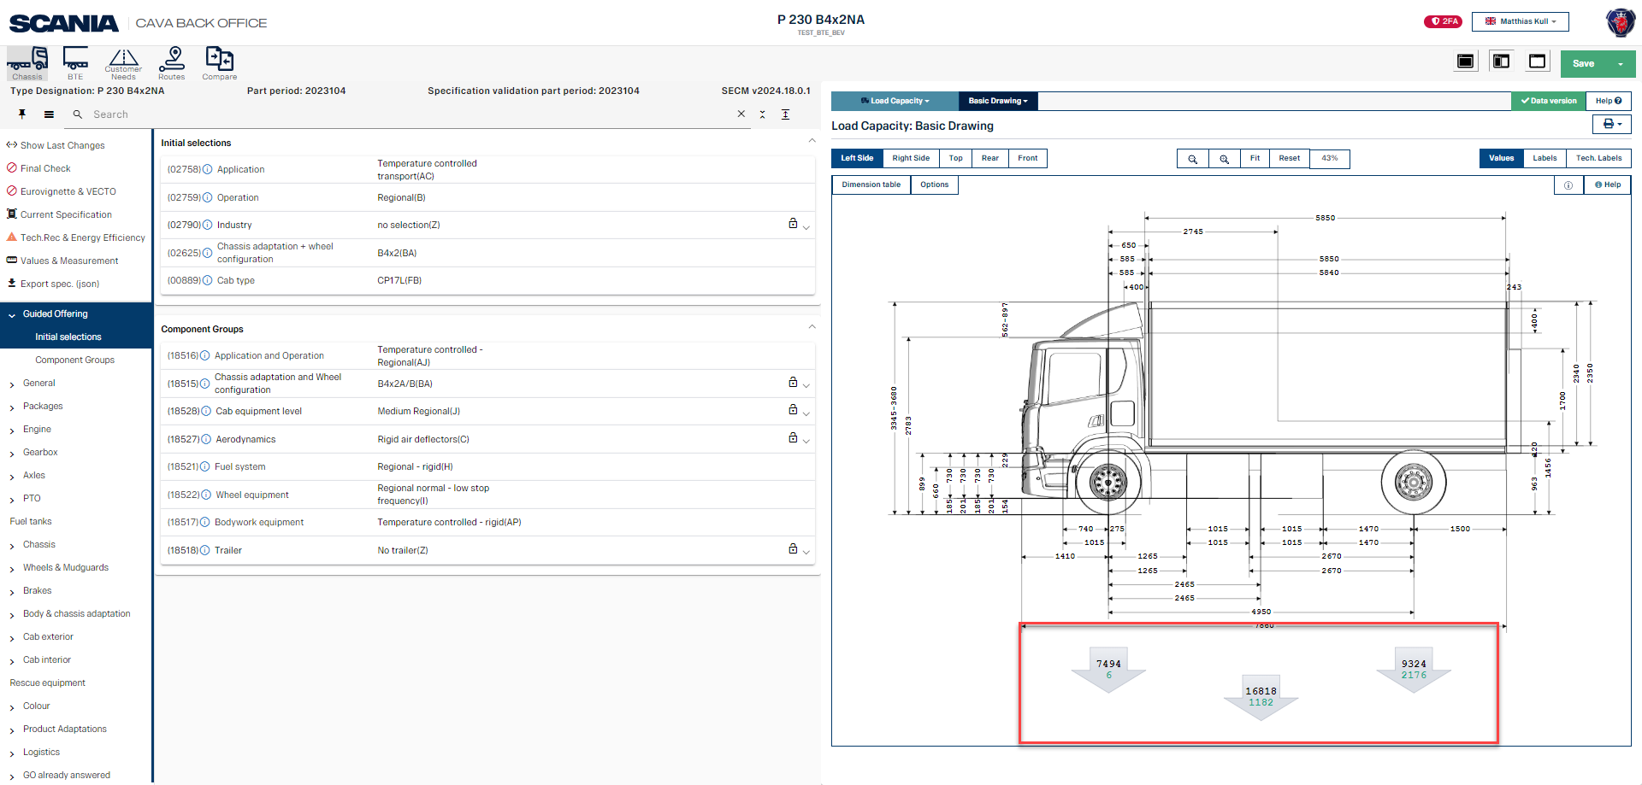
Load Capacity Basic Drawing
Notes:
In Basic Drawing you will find the weight distribution front, rear and total as well as total weight. I green highlighted the margin.

Slide 23

CAVA – Manouver Module

Slide 24
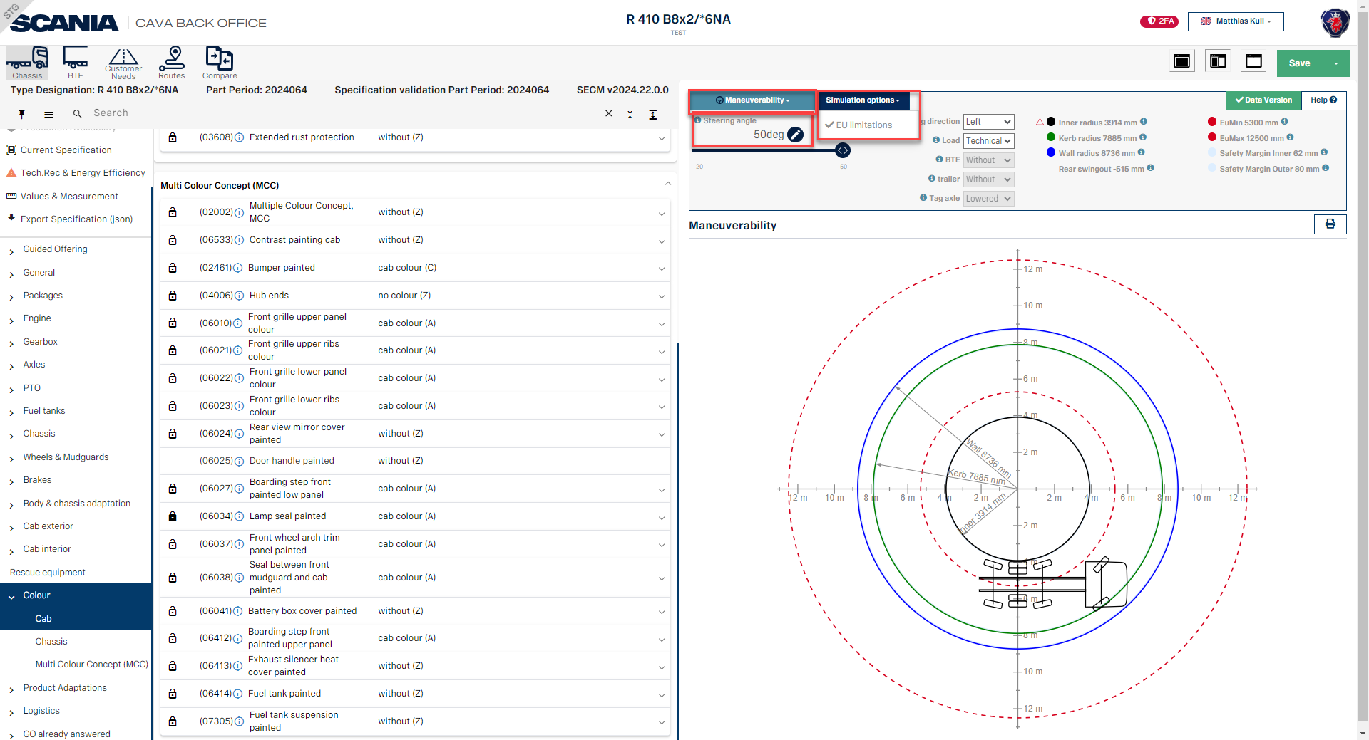
Maneover
Notes:
With the Maneuver module, you can select and simulate the different steering angles, and you will see the result of the simulation – inner radius, curve radius, and wall radius, for instance. You can also select left-hand turn and right-hand turn, as well as the legal EU minimum and maximum values.
You can generate a pdf document of the results in Maneuver by clicking the Print symbol.

Slide 25

CAVA – Compare & Result module

Slide 26
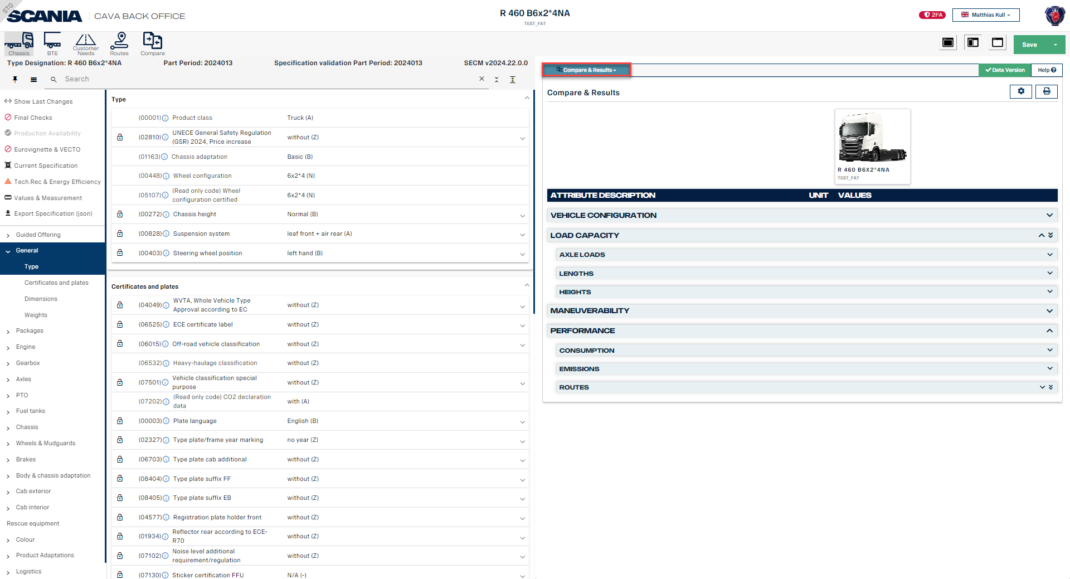
Compare & Results
Notes:
Simulation results that you will find are Axle loads, Lengths, Hights, Maneuverability, Routes

Slide 27
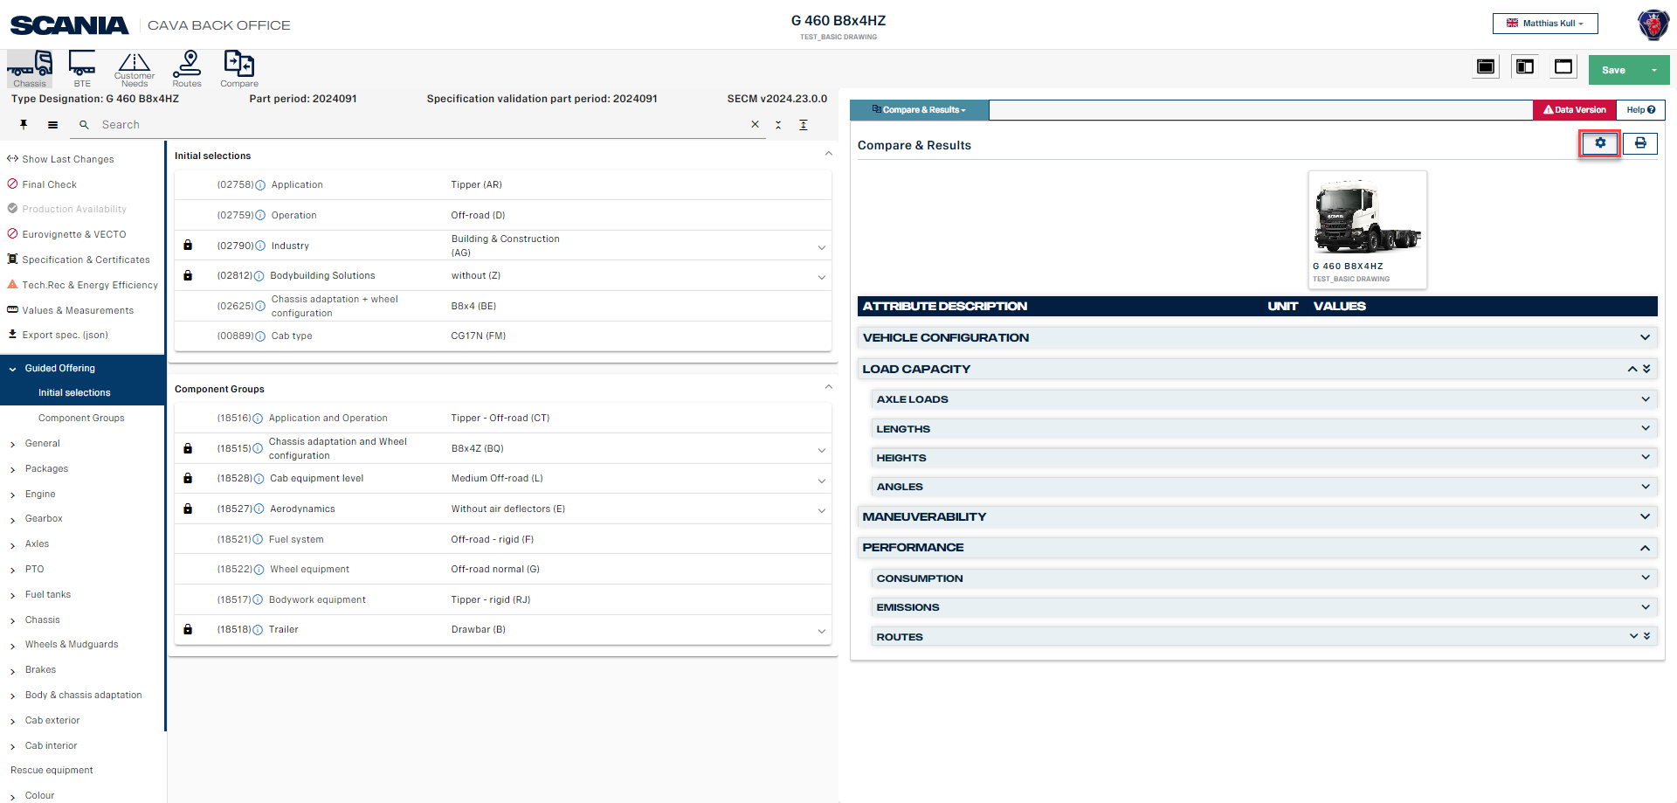
Compare & Results
Notes:
Simulation results that you will find are Axle loads, Lengths, Hights, Maneuverability, Routes

Slide 28
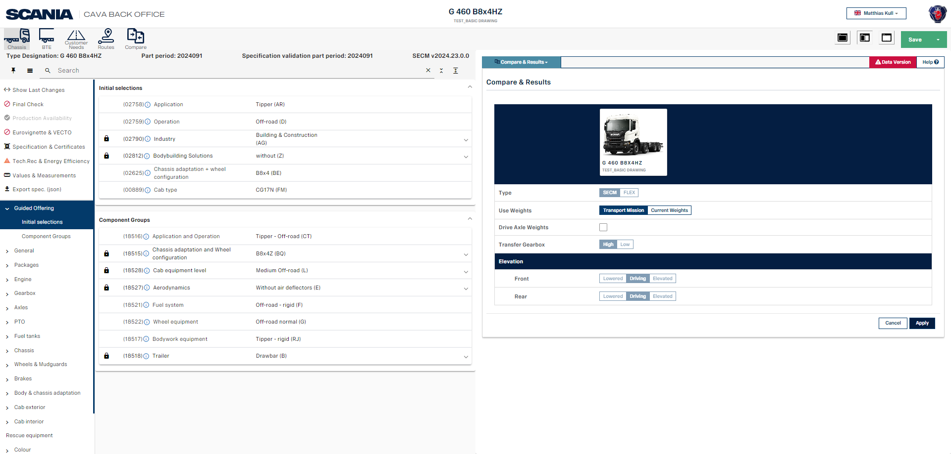
Compare & Results
Notes:
Simulation results that you will find are Axle loads, Lengths, Hights, Maneuverability, Routes

Slide 29
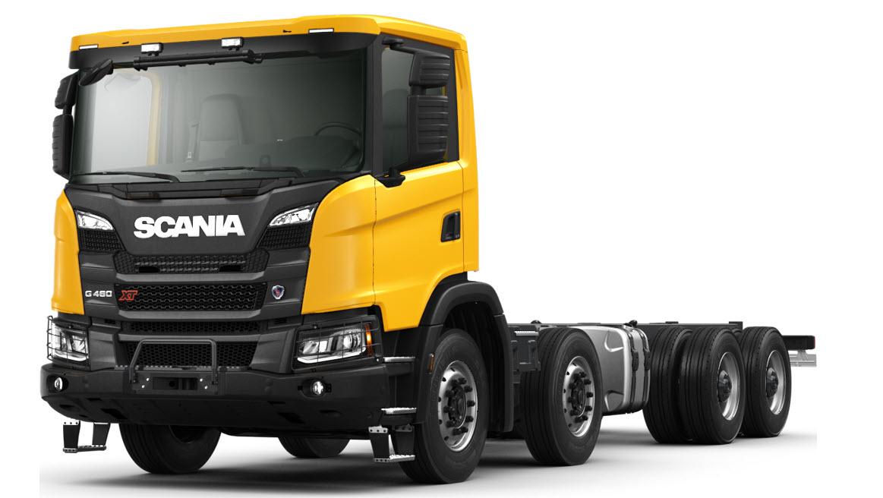
CAVA – Style and equip

Slide 30
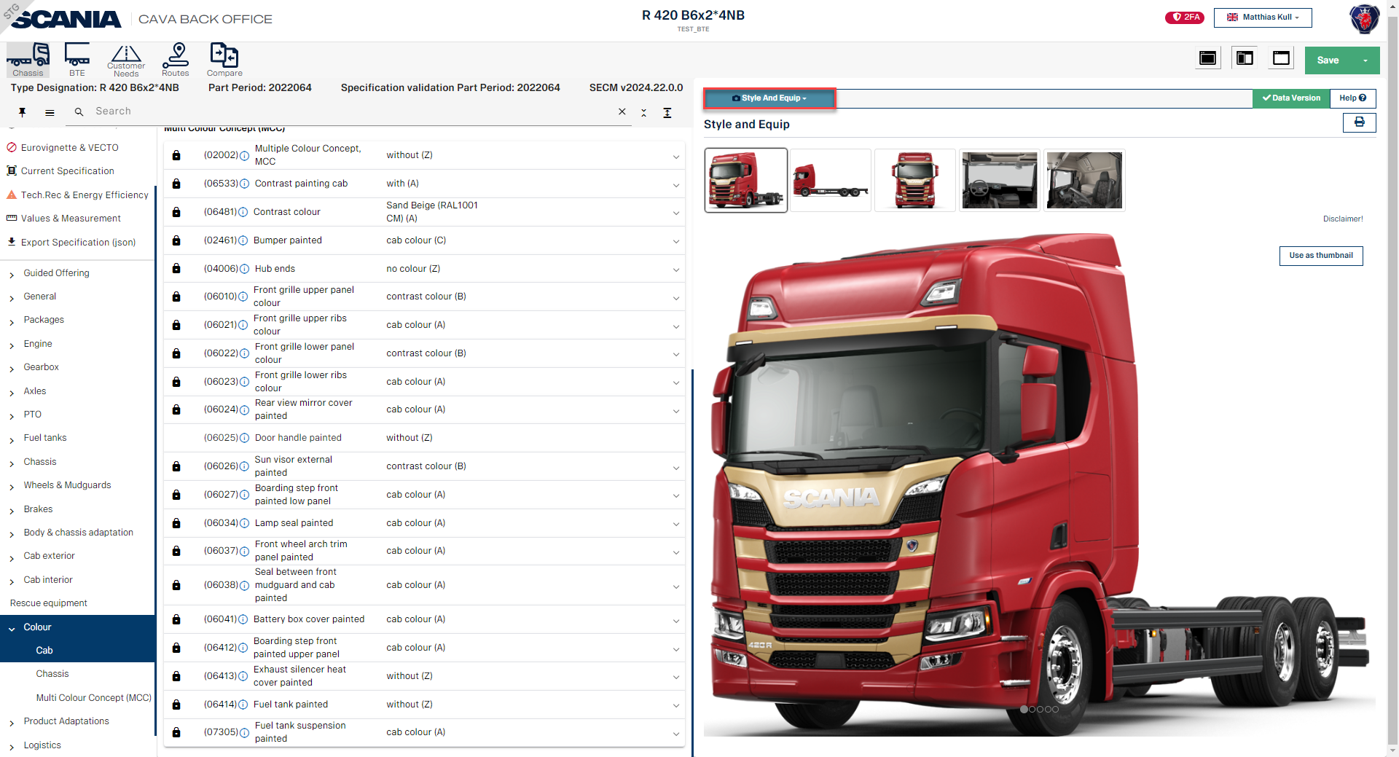
Style and Equip
In this Module you will find preliminary images of your specification in different views.
Note!
Not all components are shown in this image please order an ICD/ICS drawing
Notes:
In the Style and Equip module you will see the picture of your specification, in different views. You can also simulate the coloring of the truck, as well as specification changes – such as changes to axle distance or other components. Images are updated as changes are made.
Note that these pictures are preliminary, and it is possible that not all options are shown. It is recommended to always order an ICD/ICS drawing for the specification.

Slide 31
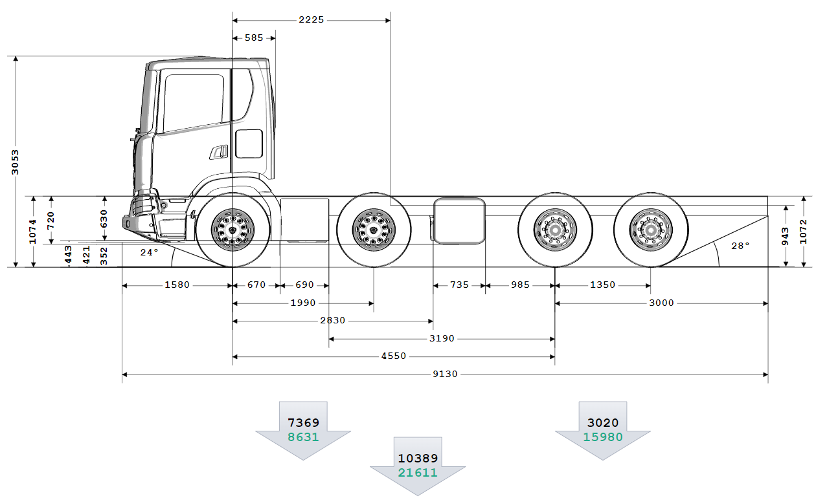
CAVA – Basic Drawing

Slide 32
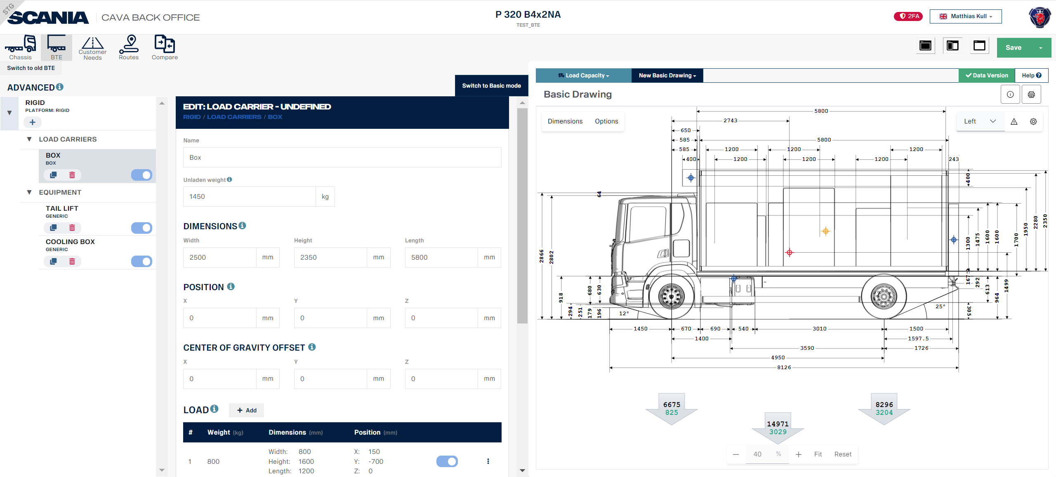
Basic Drawing
Notes:
Basic Drawing - where you can simulate the different views of the basic drawing, from your created specification. Working with the different views, you can see where components are placed on a flexible chassis specification, as well as dimentions and load distribution. For example, you can see where the fuel tanks are placed and where there is free space on the frame as well as CoG (Center of Gravity). The weights are imported from the Weight Calculation Program (front, rear and total) – as well as the margin, shown in green.

Slide 33
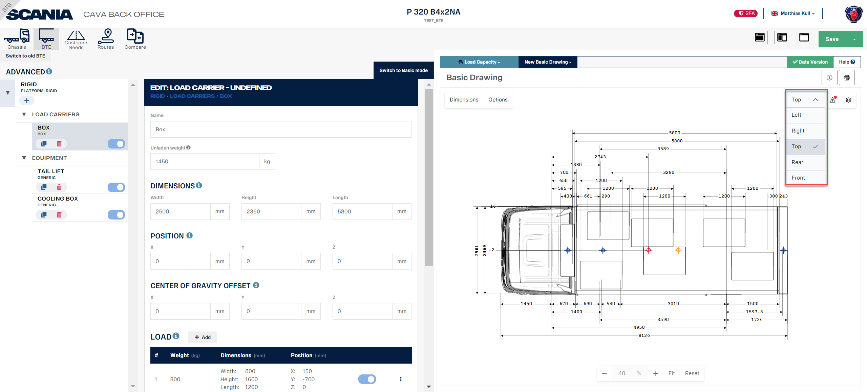
Basic Drawing Views
Notes:
You can select which view you would like to se by open the drop down and select the view.

Slide 34
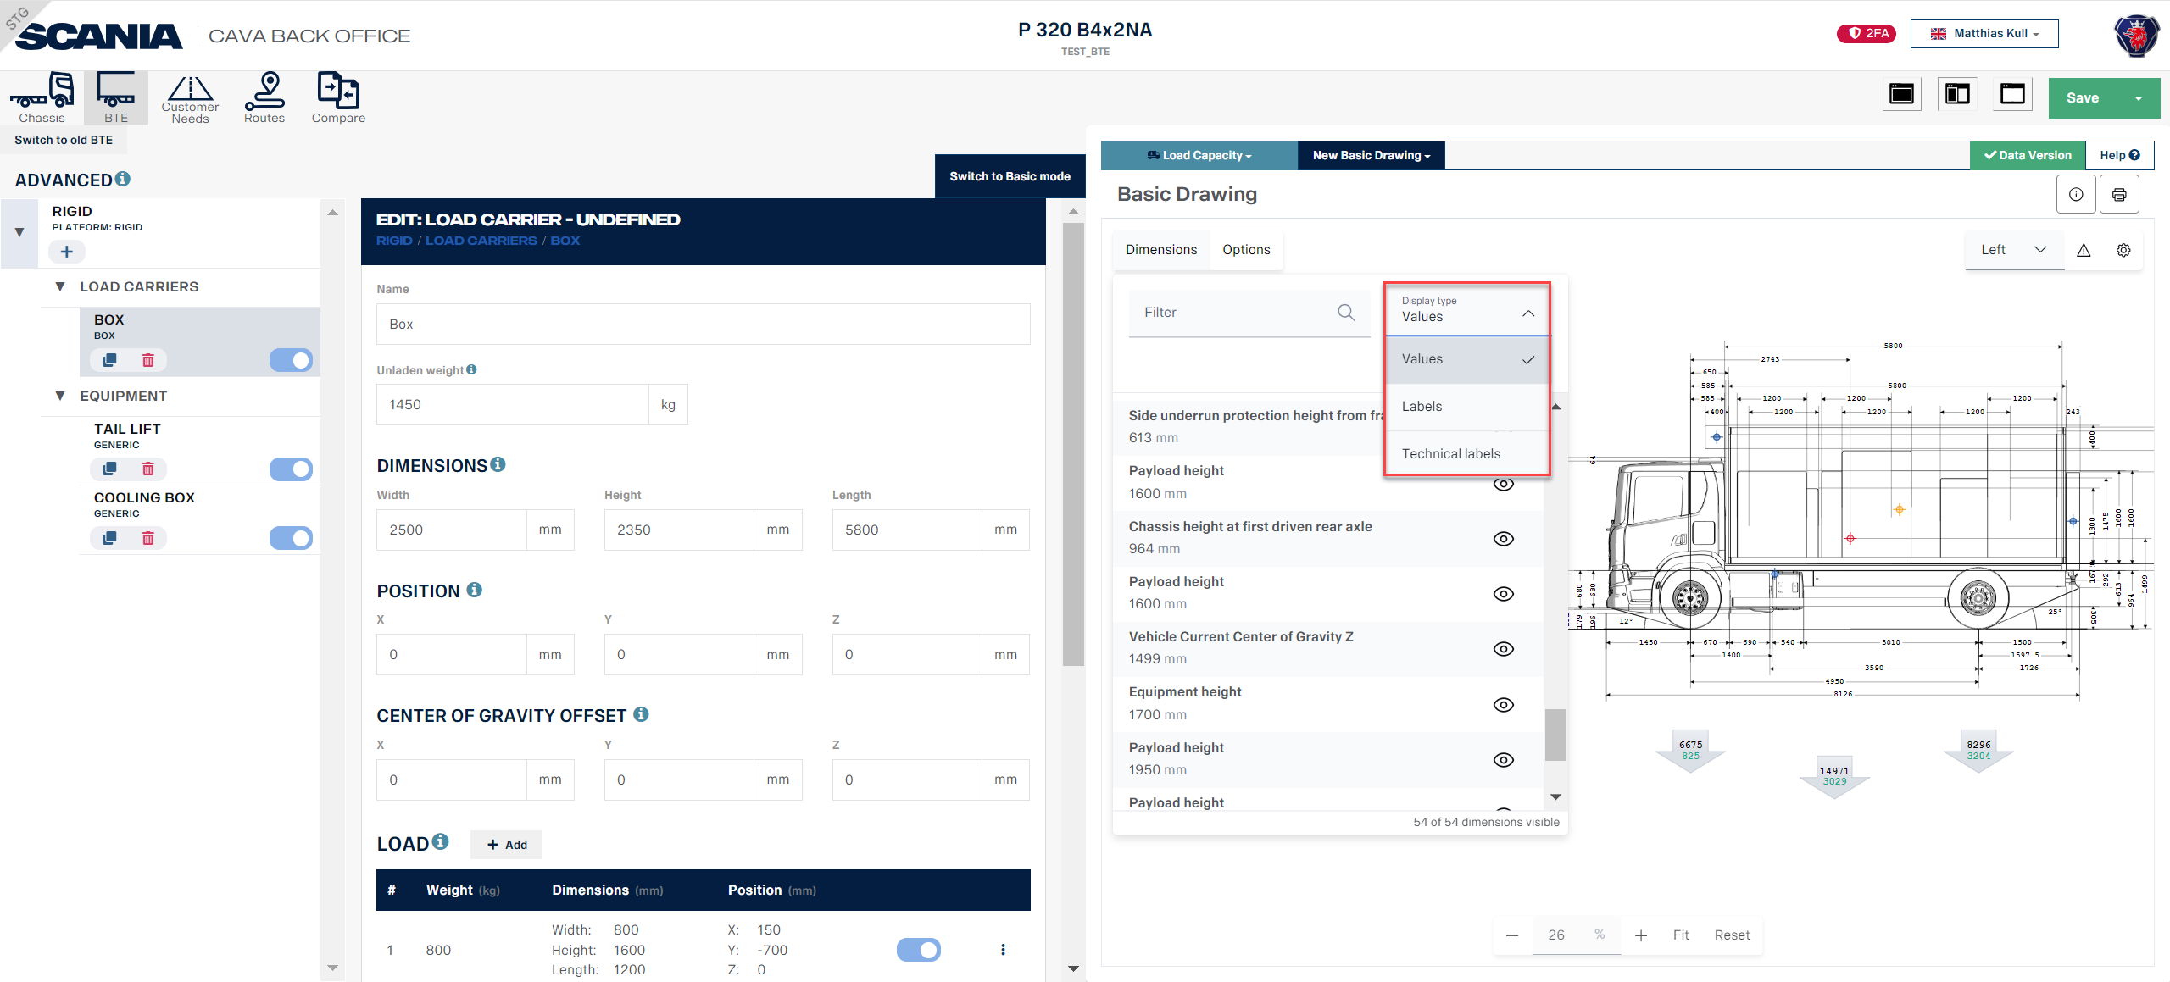
Basic Drawing (Dimensions values)
Notes:
When you click on the tab dimensions you can use a filter as well you can select the display type in values, labels or technical labels.

Slide 35
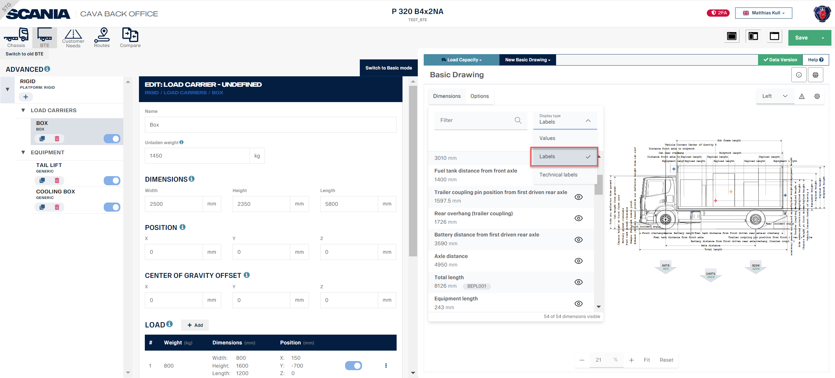
Basic Drawing (dimensions Labels)

Slide 36

Basic Drawing (dimensions Tech. Labels)

Slide 37
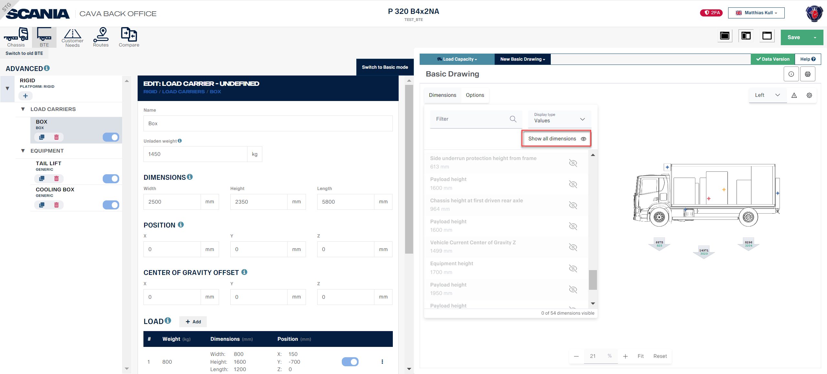
Basic Drawing (Dimension Table)
Notes:
If you would like to hide or show all dimensions you can click on the ”Eye” symbol.

Slide 38
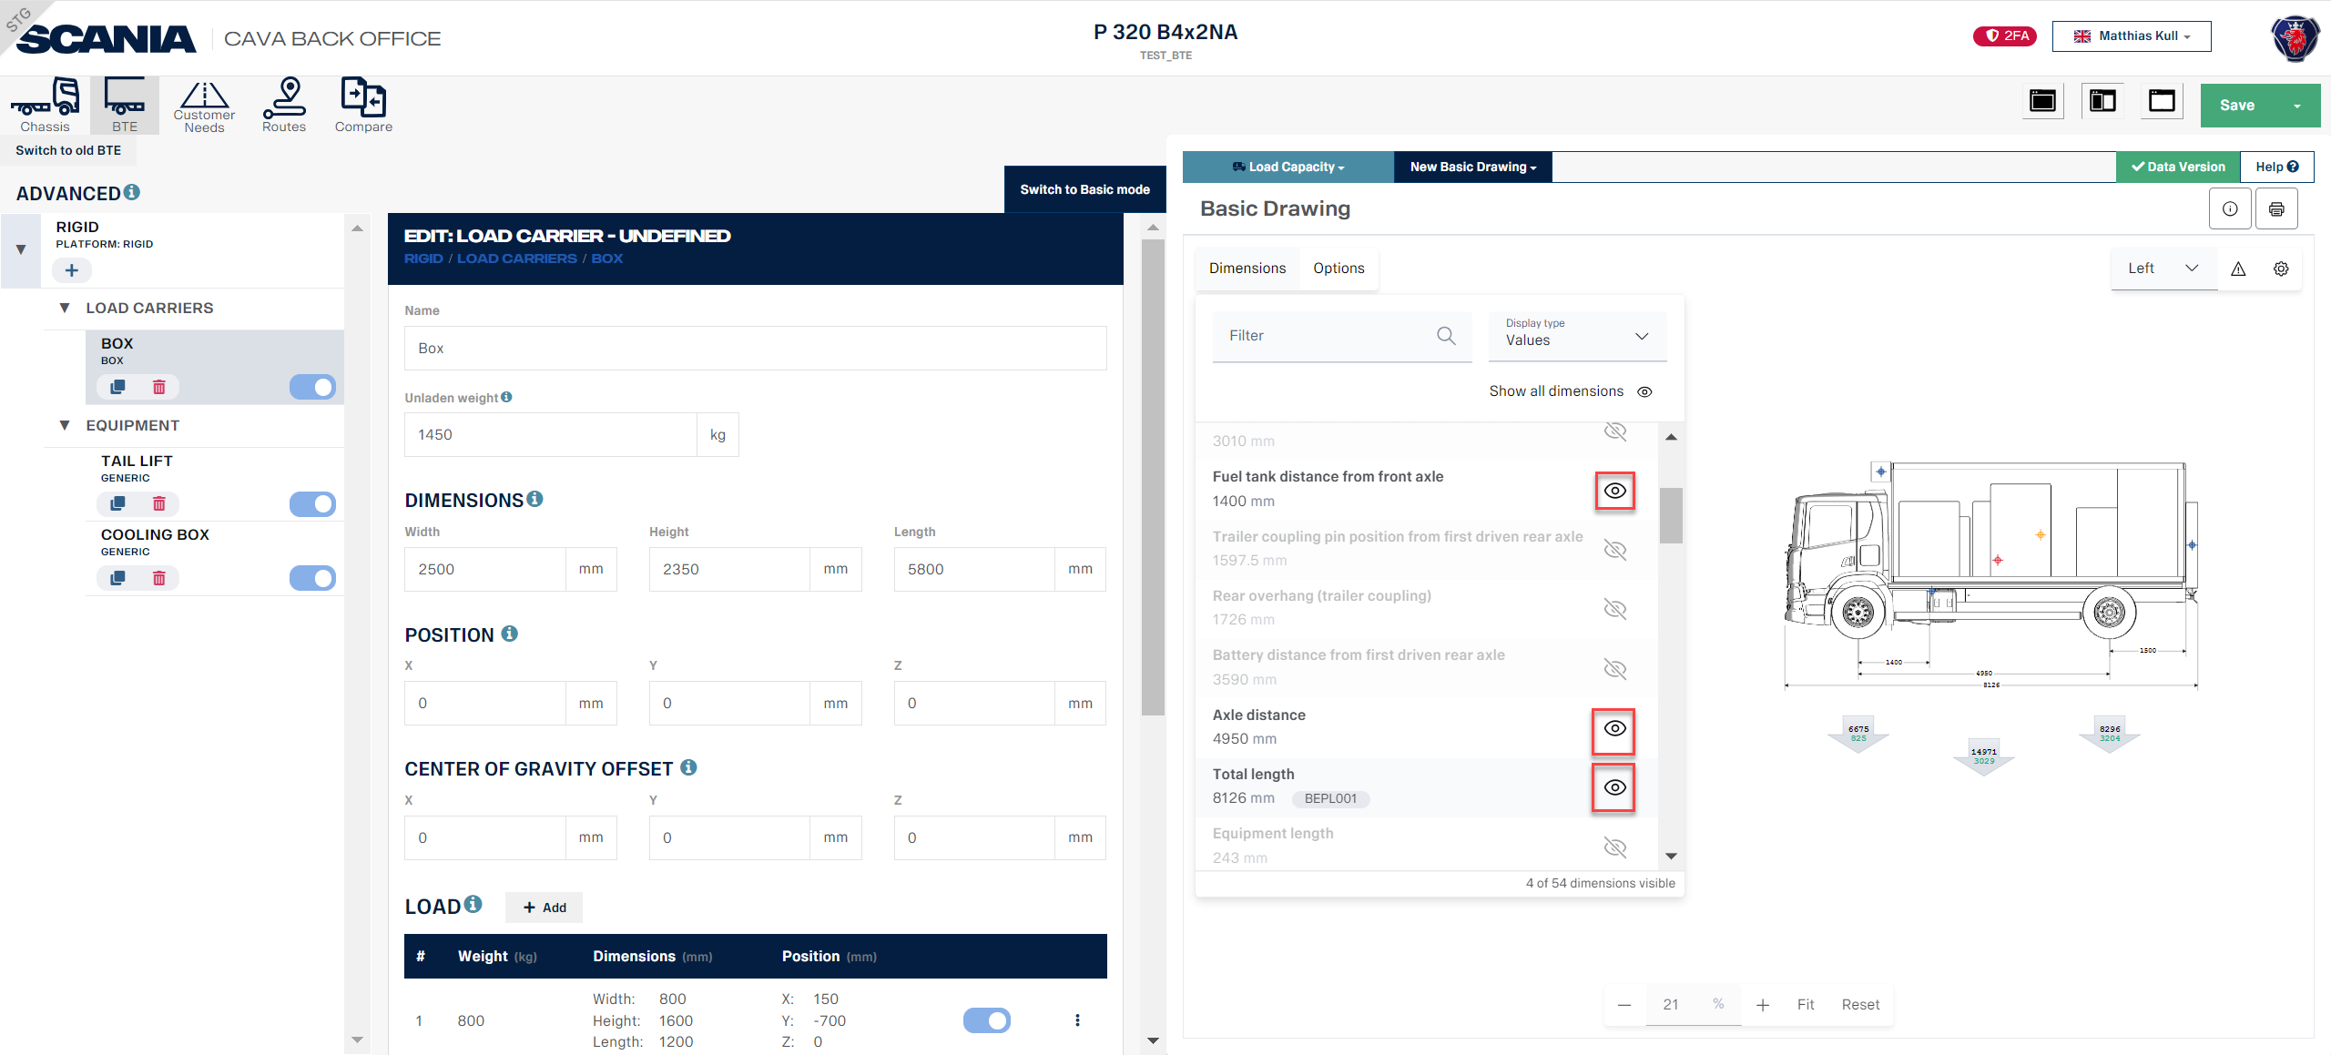
Basic Drawing (Dimension Table)
Notes:
It is possible to select dimensions that you will highlight in basic drawing to show by click on the ”Eye” symbol.

Slide 39
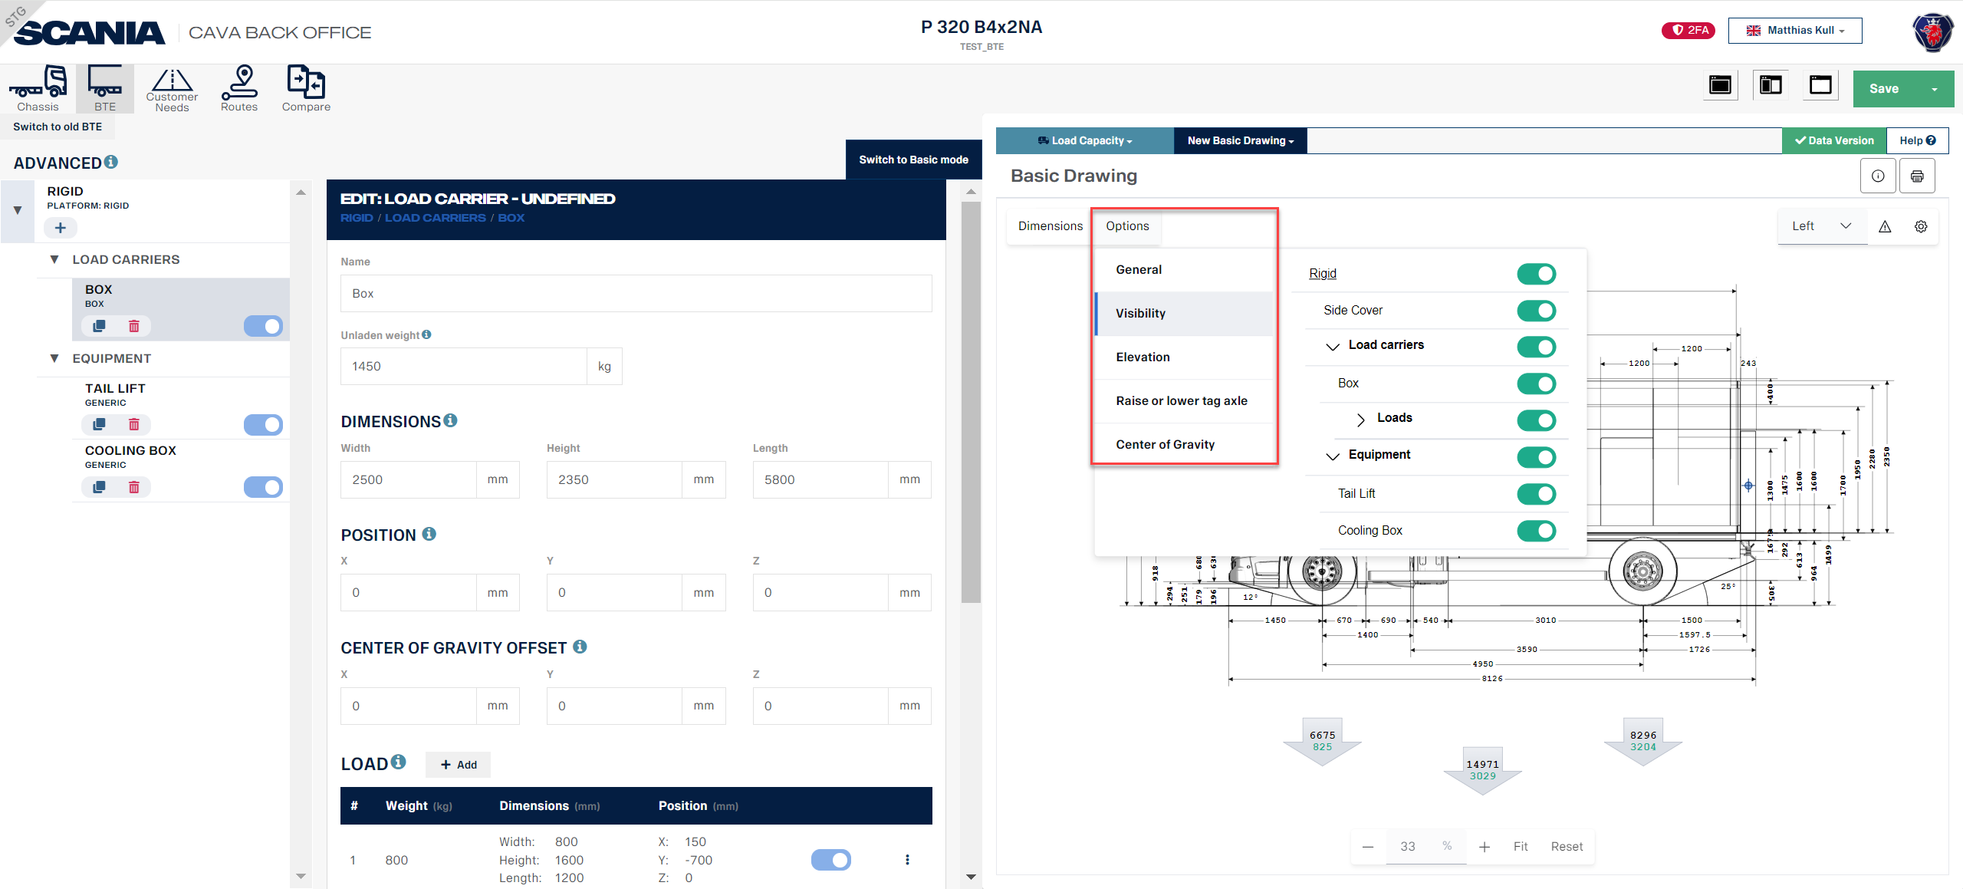
Basic Drawing (Options)
Notes:
When you click on the options tab you have the choice for different selections general, visibility, elevation, raise or lower tag axle, center of gravity.

Slide 40
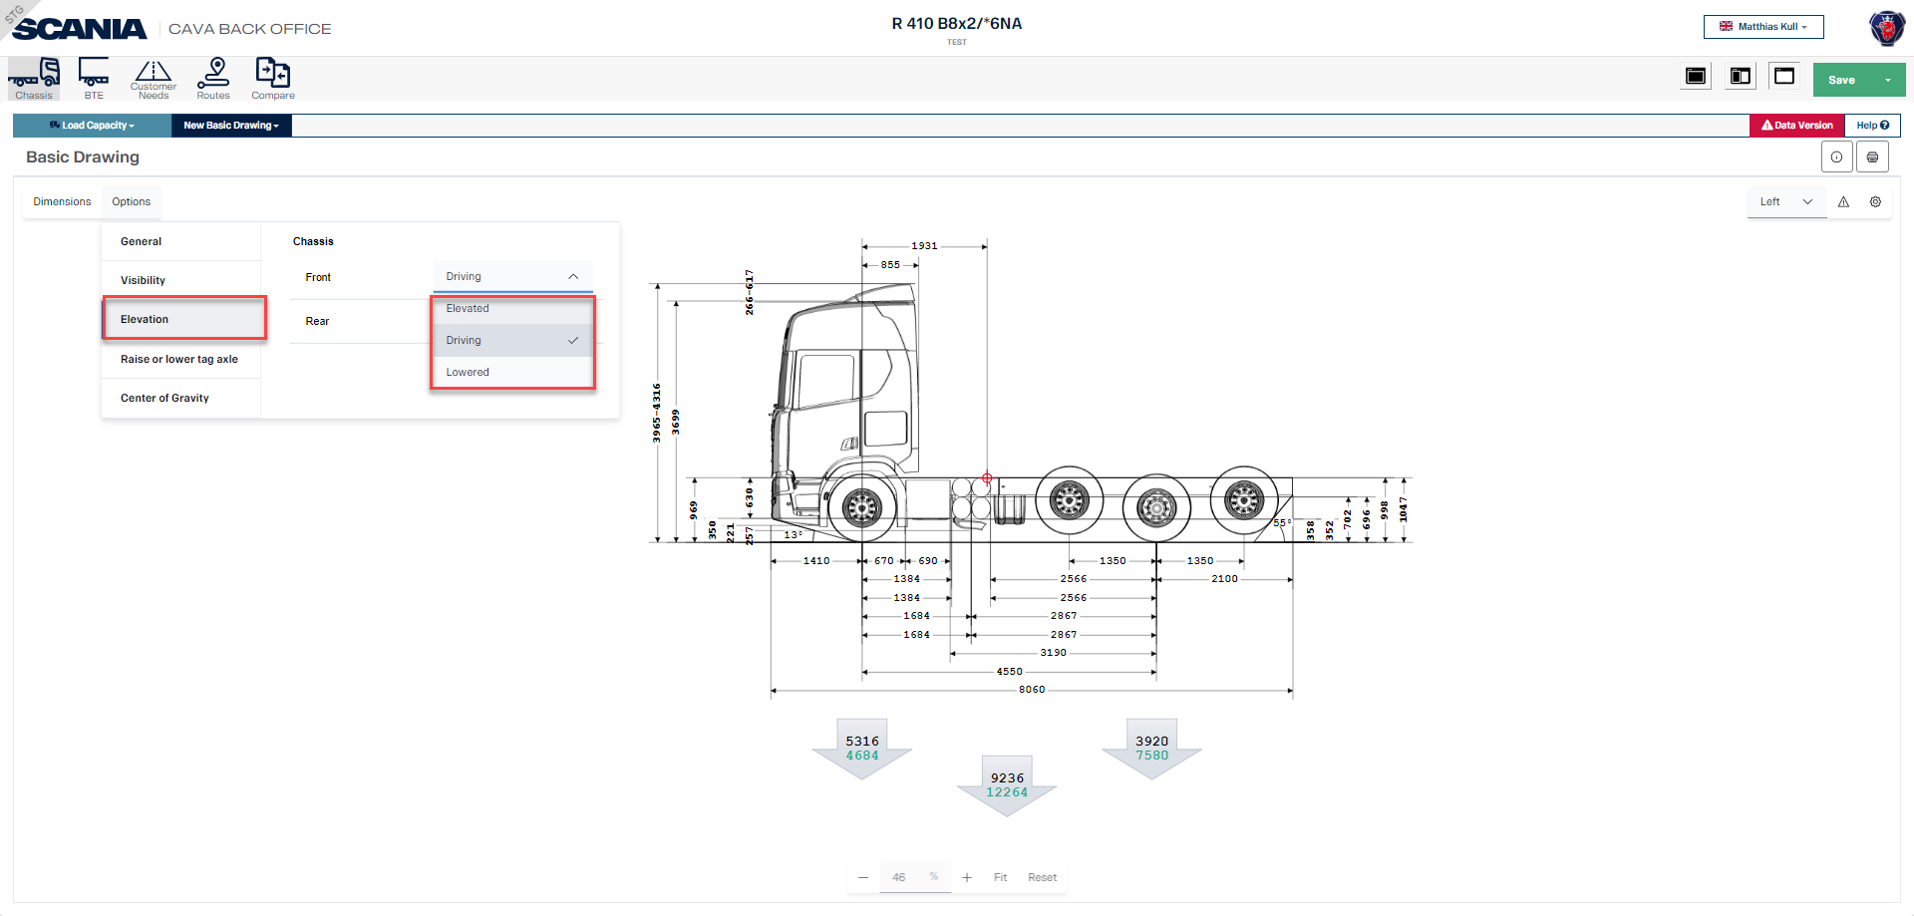
Basic Drawing (Options Elevation)
Notes:
When you click on the options tab you have the choice for different selections general, visibility, elevation, raise or lower tag axle, center of gravity.

Slide 41
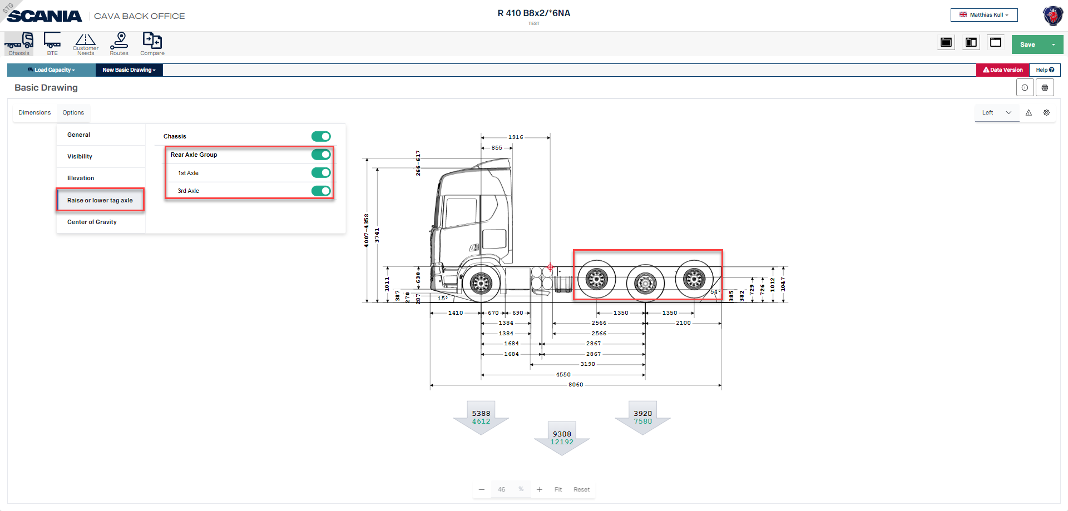
Basic Drawing (Options Axle lift)
Notes:
When you click on the options tab you have the choice for different selections general, visibility, elevation, raise or lower tag axle, center of gravity.

Slide 42
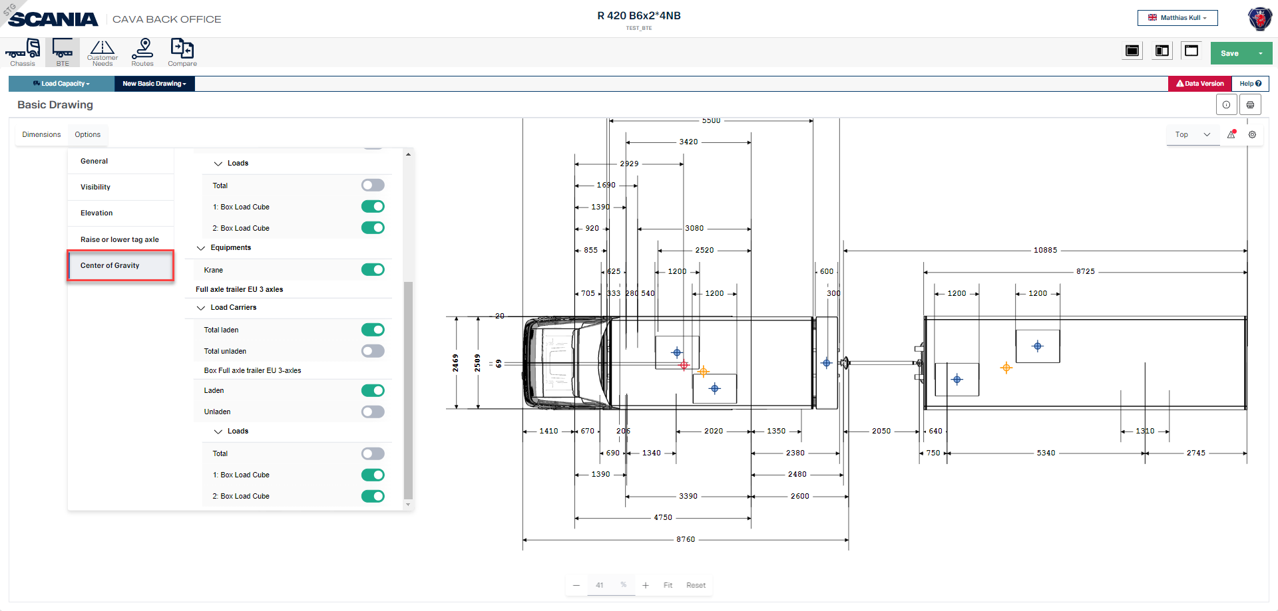
Basic Drawing (Options Center of gravity)
Notes:
When you click on the options tab you have the choice for different selections general, visibility, elevation, raise or lower tag axle, center of gravity.

Slide 43
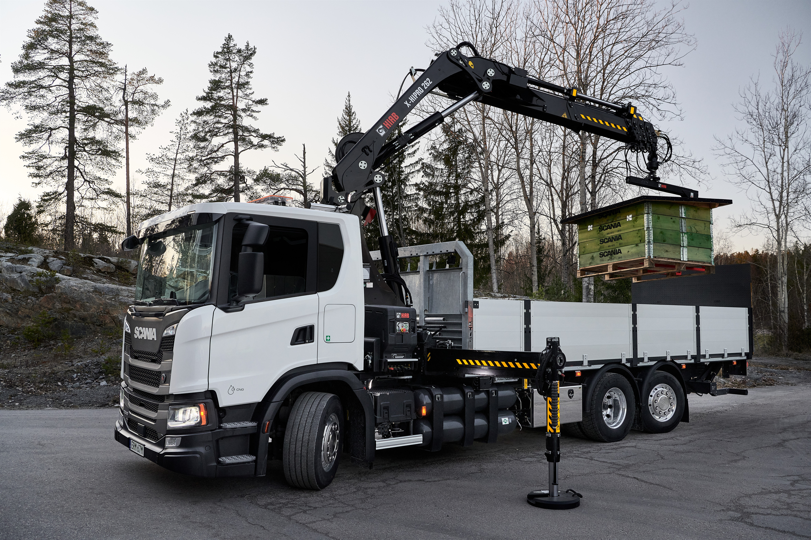
CAVA – BTE module (Body, Trailer and Equipment)

Slide 44
Body Trailer Equipment (BTE)
With the new BTE module you are able to simulate any type of bodywork on a generic level.
Notes:
With the new BTE module you are able to simulate any type of bodywork on a generic level.

Slide 45
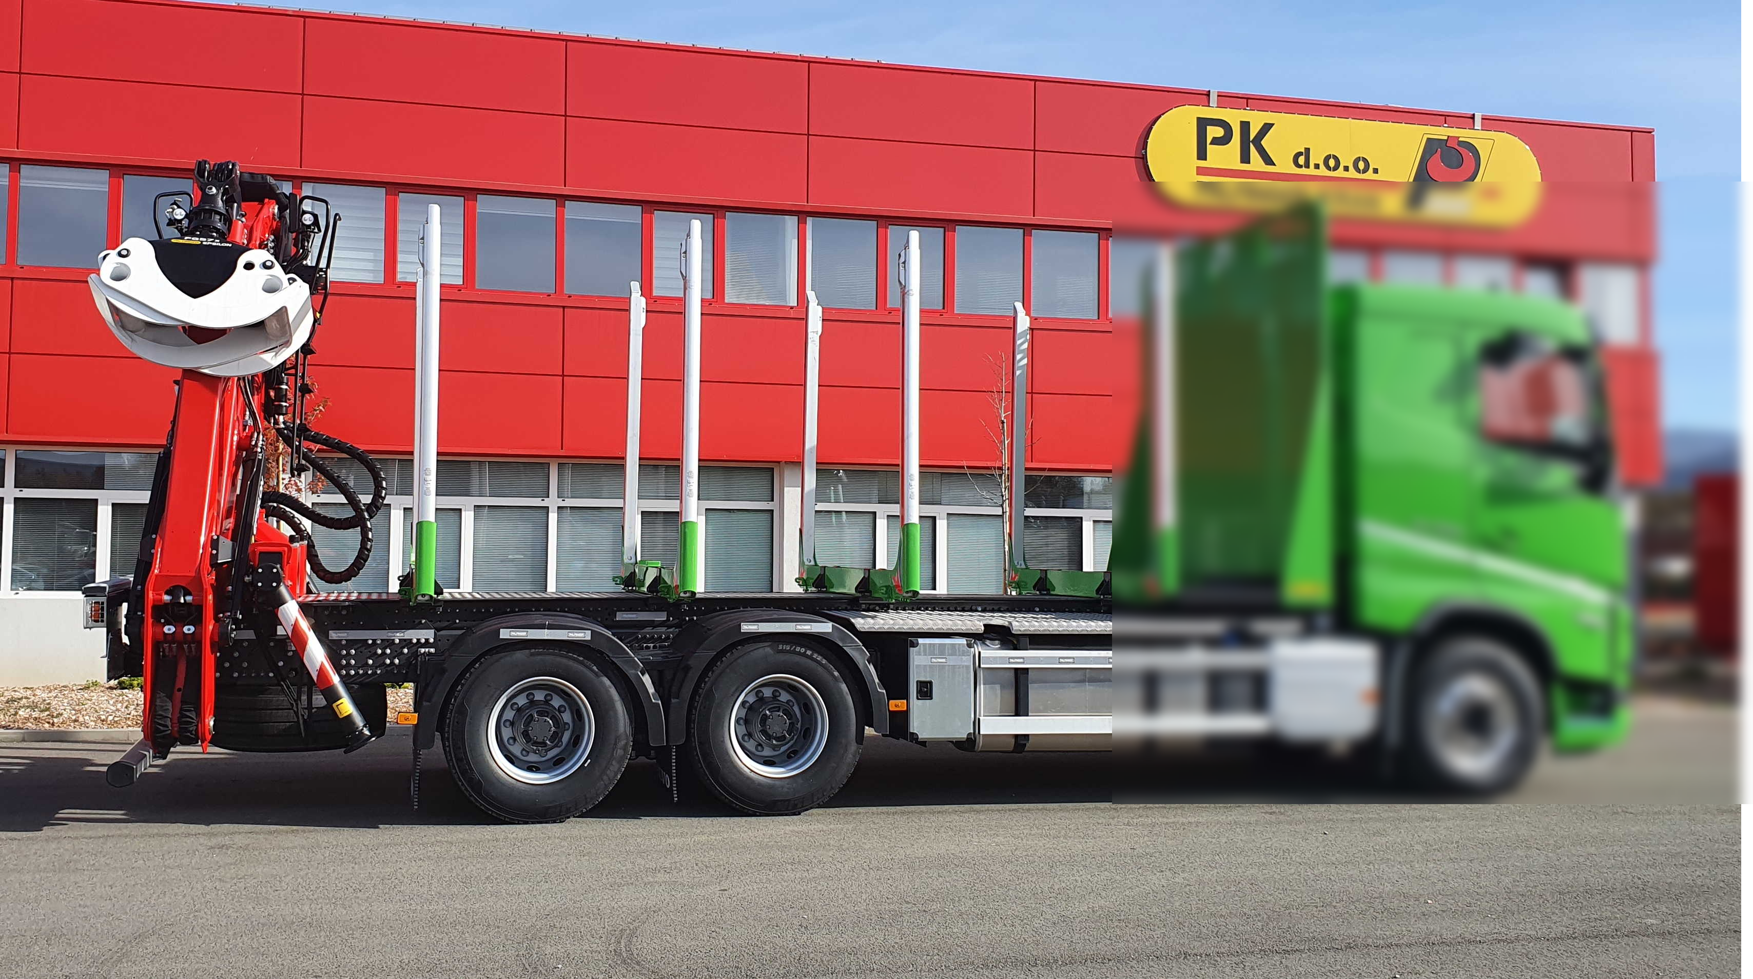
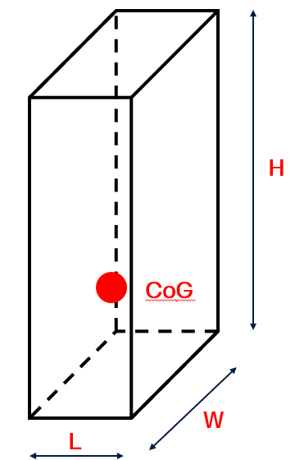
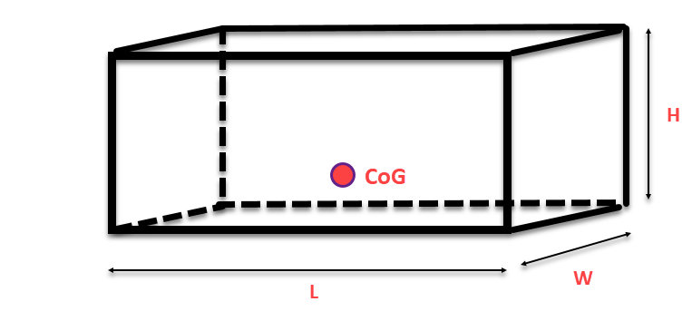
Philosophy
Any type of body or equipment can be presented as a box which has dimensions (width, height, length). Weight and Centre of Gravity.
Notes:
Any type of body or equipment can be presented as a box which has dimensions (width, height, length). Weight and Centre of Gravity.

Slide 46
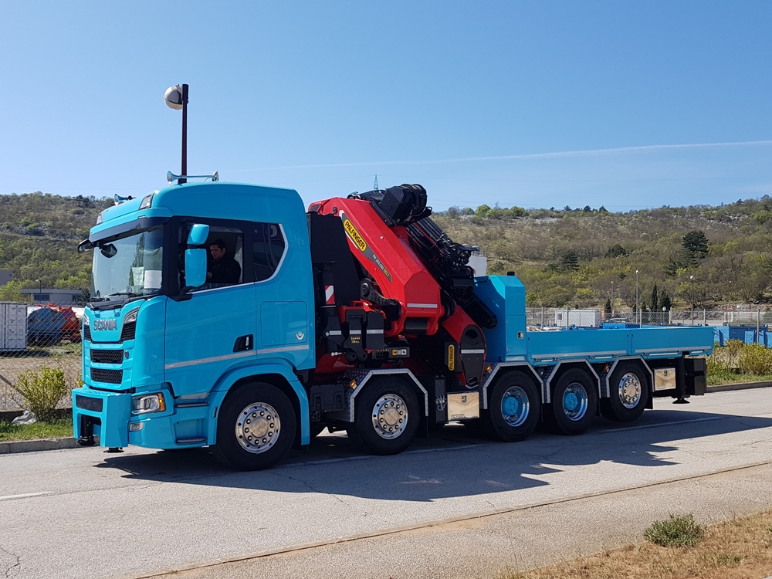
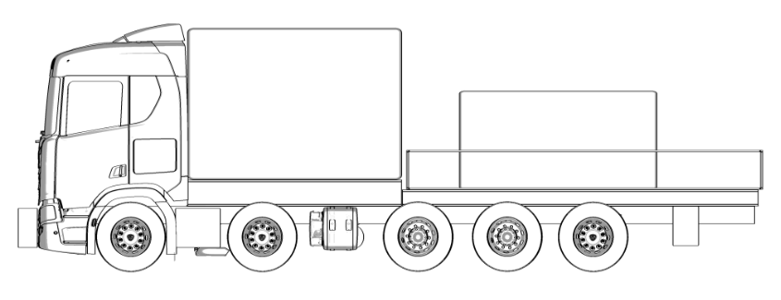
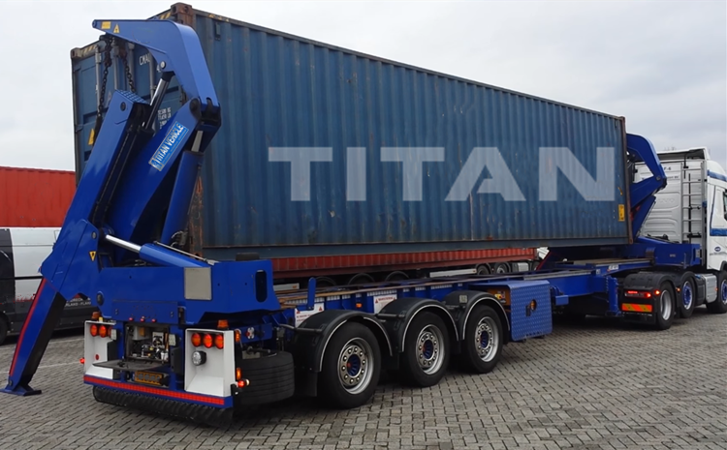
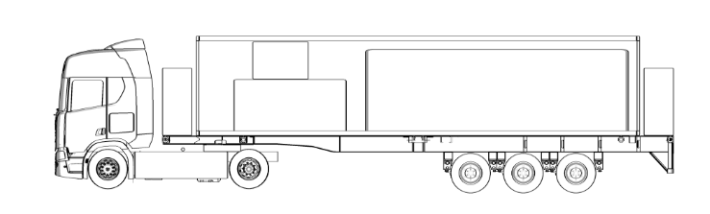
Body and equipment
Notes:
Two examples for body and equipment.

Slide 47
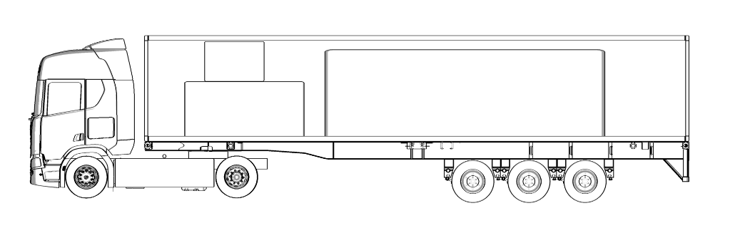
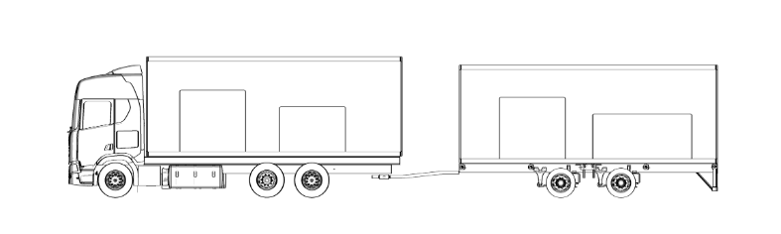
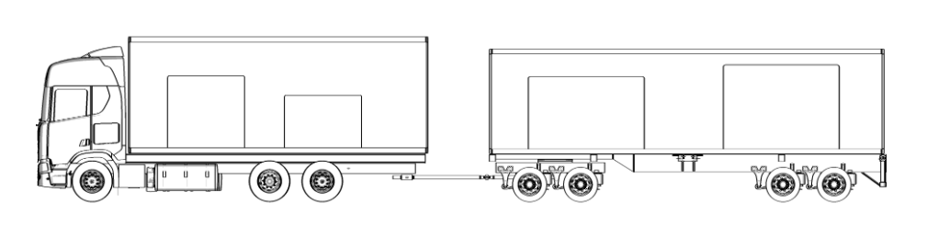
Trailers in the BTE module
Semi-trailer
Centre-axle trailer
Full-axle trailer
Notes:
The trailers that are available to select in CAVA Back Office are Semi-trailer, Center-axle trailer, Full-axle trailer.

Slide 48
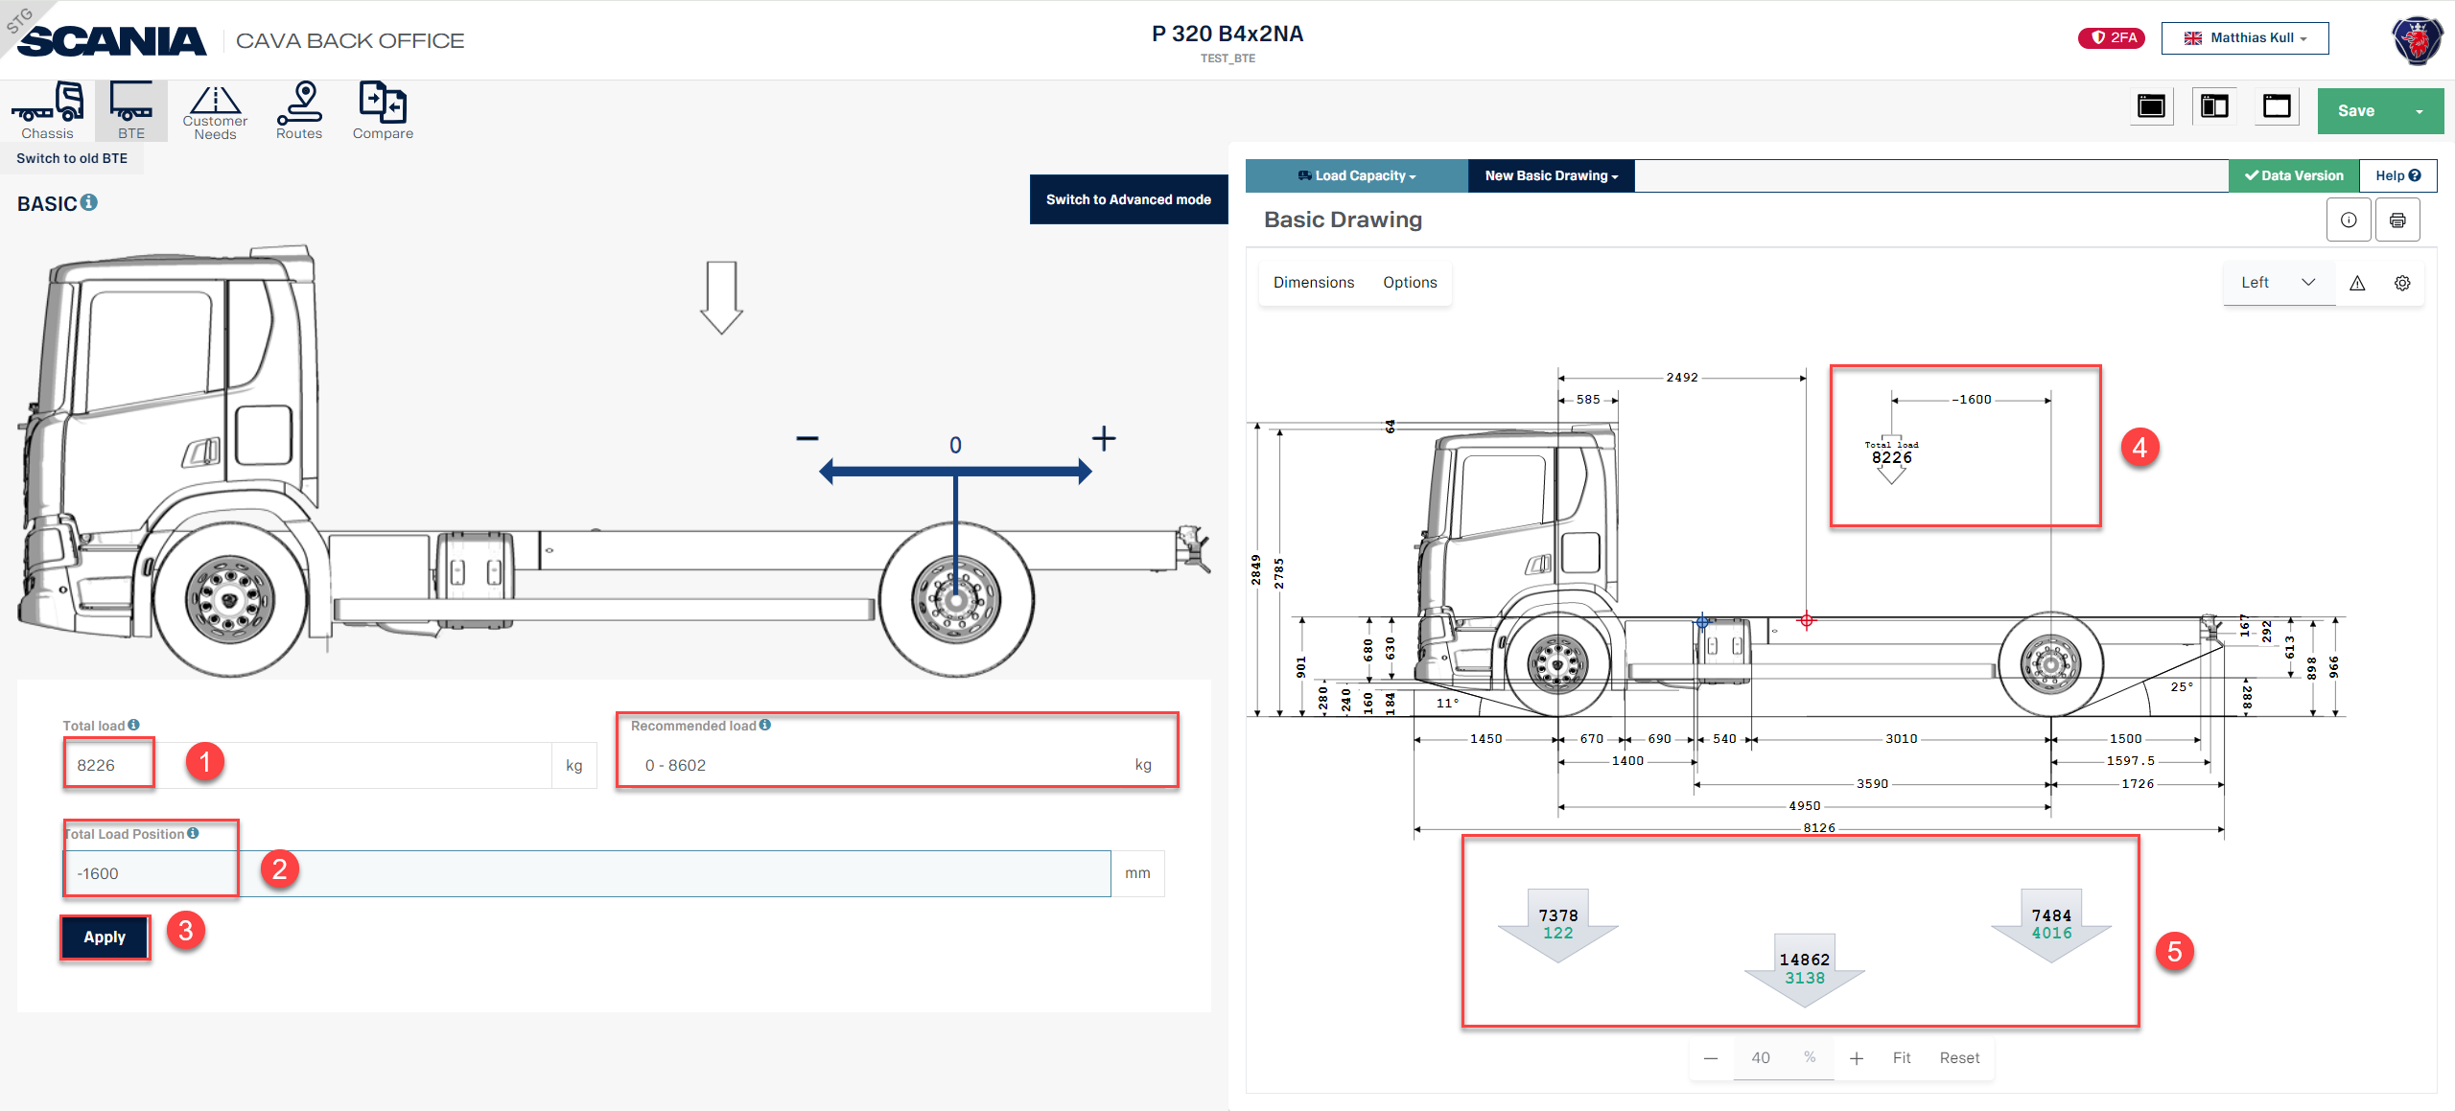
BTE (Body, Trailer, Equipment) Basic
Notes:
You can simulate the load for BTE (Body Trailer Equipment) with two options Basic and Advanced.
Basic is good to use if you would like to simulate a semitailer by entering the weight for the semitrailer including load.
The position of the fifth wheel has been filled in automatically according to what you have specified in the SECM configurator.

Slide 49

CAVA BTE Advanced Rigid Subframe
Notes:
In Rigid you can add subframes there is a recommended length you can use to cover the optimal lenght for the subframe.

Slide 50



Position of Load Carirer
Vehicle reference point is at minimum permitted distance between rear cab wall and bodywork (BEP-L 102), on top of the frame or subframe if selected and in the middle of vehicle.
Notes:
Vehicle reference point is at minimum permitted distance between rear cab wall and bodywork (BEP-L 102), on top of the frame or subframe if selected and in the middle of vehicle.

Slide 51

Position of Load Carirer
Y component of the position is the difference between middle of the vehicle and middle of the Load carrier.
Notes:
Position of the load carrier in relevance to a plattform (chassis and/or trailer)
- X positon = horizontal position
In case of a chassis the horizontal position deffinition is the minimum distance between the cab rearwall and the beginning of the load carrier (BEP-L102)
- Z positon = vertical positon
In case of a chassis the vertical possition deffinition is on top of the frame or subframe if present.
- Y position = difference between middle of the plattform (chassis and/or trailer) and middle of the load carrier

Slide 52

CAVA BTE Advanced Load Carrier (Box)
Notes:
Rename your load carrier to the bodywork you would like to simulate and fill in all needed information in the field highlighted in red.

Slide 53

CAVA BTE Advanced Load Carrier
(Load inside the box)
Notes:
You are able to put load inside the load carrier either one or multiple loads and where there are placed in the load carrier can be simulated.

Slide 54

CAVA BTE Advanced Load Carrier
(Load inside the box Top View)
Notes:
If you have created multiple loads you can see event better where the objects are placed in the load carrier by changing the view to ”Top”.

Slide 55


Position of Equipment
Vehicle reference points:
1st front axle *
1st rear driven axle *
behind cab *
end of rear overhang *
*On top of the frame and in the middle of vehicle
Notes:
Vehicle reference points:
1st front axle *
1st rear driven axle *
behind cab *
end of rear overhang *
*On top of the frame and in the middle of vehicle

Slide 56

Position of Equipment
Y component of the position, is difference between middle of the vehicle and middle of the Equipment.
Notes:
The possition of the equipment in relevance to a plattform (chassis and/or trailer) based on the reference point you have seleced.
The reference points that you can select are on top of the frame and in the middle of the plattform.
X position = horizontal position
Z position = vertical positon
Y position = difference between middle of the plattform and middle of the equipment

Slide 57

CAVA BTE Advanced Eqipment (Tail Lift)
Notes:
When you are adding equipment than name the equipment in this example ”tail lift” and ”cooling box” fill in all needed information for the equipment you would like to simulate.

Slide 58

CAVA BTE Advanced Eqipment (Cooling Box)
Notes:
When you are adding equipment than name the equipment in this example ”tail lift” and ”cooling box” fill in all needed information for the equipment you would like to simulate

Slide 59

CAVA BTE Advanced Eqipment (Cooling Box)
Notes:
If you would like to see where your cooling unit is placed you can change the view in this example to the ”Front” view.

Slide 60

CAVA BTE Advanced Semitrailer
Notes:
To add a trailer plattform you need to click on connect plattform and select the trailer that you would like to add for a tractor unit ”Semi-trailer” for Rigid ”Full-axle trailer or Center-axle trailer”.

Slide 61

CAVA BTE Advanced Semitrailer
Notes:
You can add a load carrier and equipment to your trailer the principle is the same as for bodywork descibed before.

Slide 62

CAVA BTE Advanced Semitrailer
Notes:
You are able to put load inside the load carrier either one or multiple loads and where there are placed in the load carrier can be simulated.

Slide 63

CAVA Maneuver with semi-trailer

Slide 64

CAVA BTE Advanced Semi-trailer (Example)
Notes:
Just to show you that you are able to create a trailer exactly as you would likte to have it.

Slide 65

CAVA BTE Centre axle trailer
Notes:
To add a ”center-axle trailer” follow the steps highlighted in red.

Slide 66

CAVA Maneuver with
Centre axle trailer
Notes:
In Maneuver you are able to simulate your trailer.

Slide 67

CAVA BTE Full axle trailer
Notes:
To add a ”full-axle trailer” follow the steps highlighted in red.

Slide 68

CAVA Maneuver with
Full axle trailer Example
Notes:
In Maneuver you are able to simulate your trailer.

